Slide 1


Screening for Dementia in Persons Living with an Intellectual Developmental Disability
Jody Krainer, MSW, LCSW, MBA
NTG Affiliated Regional Trainer
Dementia Diagnostic Clinic Network Manager
Wisconsin Dementia Resource Network
Crisis Prevention Summit April 23, 2026

Slide 2

Overview of Session
Identify the challenges in detecting dementia in those living with an intellectual developmental disability (IDD).
Provide an overview of National Task Group – Early Detection Screen for Dementia (NTG-EDSD) tool.
Increase your knowledge on “how to”, and when to complete the NTG-EDSD tool.
Identify the benefits and drawbacks of the NTG-EDSD tool.
I have no relevant financial relationships I need to disclose.

Slide 3
Developmental Disability
The term "developmental disabilities" is a broader category that includes intellectual, physical, or both.
This presentation will focus on those living with an intellectual developmental disability and will be referenced as “IDD”.
Individuals living with IDD are living longer. For example, the average life expectancy for an individual living with Down Syndrome born in,
1960’s, was 10 years
1980’s, was 25 years
today, it is 60-65 years
As a result, there is an increased risk for age-related health conditions, including the increased risk for dementia as they age.
NIH: https://www.nichd.nih.gov/health/topics/idds/conditioninfo/default
Life Expectancy

Slide 4
The Aging Brain
Replace with animated, updated version
Age-Associated “Normal Aging”
Mild Cognitive Impairment (MCI)
Dementia
Cognition
the brain’s abilities
Middle Adulthood
Death
Age

Slide 5
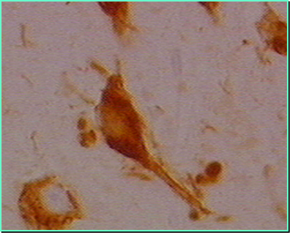
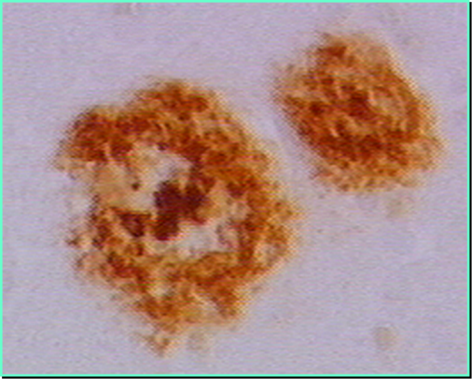
Genetic Risk for Alzheimer’s Disease
Alzheimer’s Disease and Down Syndrome
Individuals living with Down syndrome are born with an extra full or partial copy of chromosome 21, which carries the APP gene.
The gene produces a protein called amyloid precursor protein (APP).
Too much APP leads to clumps called beta-amyloid plaques.
By age 40, most individuals with Down syndrome have the plaques, along with tau tangles.
National Institute on Aging: Eunice Kennedy Shiver, National Institute of Child Health and Human Development

Slide 6
Prevalence of Alzheimer’s Disease and Down Syndrome
National Down Syndrome Society: Aging and Down Syndrome: A Health & Well-Being Guidebook: http://www.ndss.org/wp-content/uploads/2017/11/Aging-and-Down-Syndrome.pdf

Slide 7
IDD and Dementia
The challenges in detecting dementia in the IDD population include:
Common medical problems within the population can mimic dementia, e.g., untreated sleep apnea, thyroid dysfunction, severe constipation.
The presence of dementia tends to be expressed differently within the population, often marked by personality and behavior changes.
The individual’s baseline cognitive deficits restrict or eliminate the use of standardized tools used in typical dementia evaluation protocols.
The individual’s starting level of functional skills are typically less than the general population.
Assessment and Diagnosis of Dementia in Individuals with Intellectual Disability: A Toolkit for Clinicians and Caseworkers – Dr. Gregory D. Pritchett, Psy.D. March 6, 2017

Slide 8

Diagnosing Dementia
There needs to be a noticeable, measurable decline in the person’s cognitive abilities, a decline from a previous higher level.
There needs to be a noticeable decline in the person’s function, a decline from a previous higher level.
The cognitive/behavior changes are not due to a medical or psychiatric reason.

Slide 9
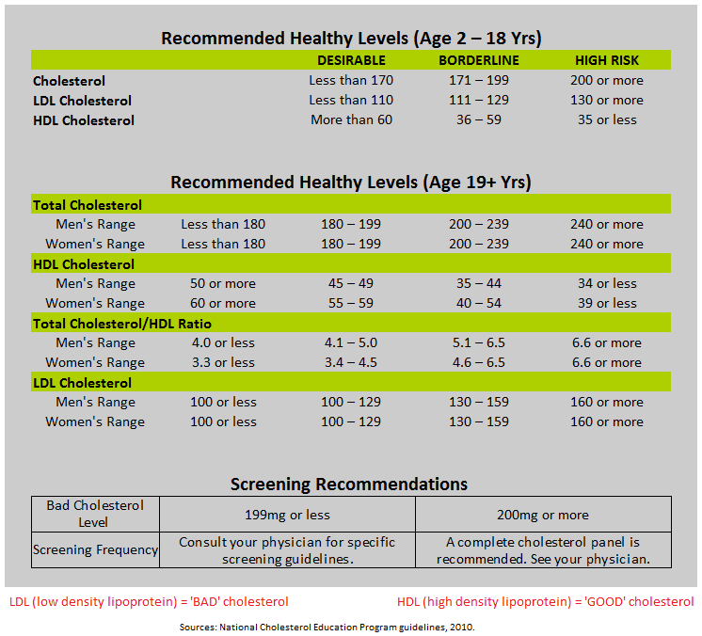
Biomarker Norms
We have established norms for many indicators on how the body and brain are doing:
Blood pressure
Weight
Blood composition
Pulse
Blood volume
Heart rate
Body Max Index (BMI)
Cognitive tools (i.e., MoCA, MMSE, the Clock Draw, RBANS, TRAILS…)
Behavior Health (i.e., Geriatric Depression Screening – GDS)
The norms were established through large research projects.

Slide 10
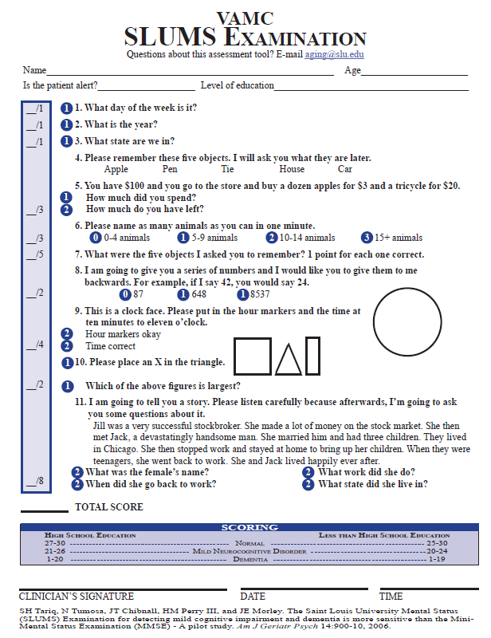
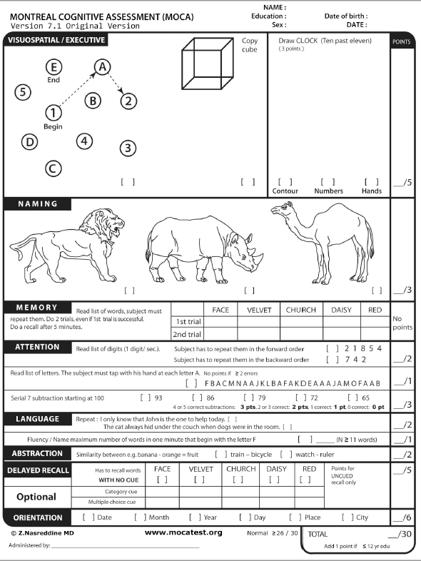
Diagnosing Dementia
There needs to be a noticeable, measurable decline in the person’s cognitive abilities, a decline from a previous higher level.
There needs to be a noticeable decline in the person’s function, a decline from a previous higher level.
The cognitive/behavior changes are not due to a medical or psychiatric reason.

Slide 11
ADLs
Dressing
Bathing/grooming
Toileting
Eating
Ambulation
Diagnosing Dementia
IADLs
There needs to be a noticeable, measurable decline in the person’s cognitive abilities, a decline from a previous higher level.
There needs to be a noticeable decline in the person’s function, a decline from a previous higher level.
The cognitive/behavior changes are not due to a medical or psychiatric reason.
Driving
Food preparation Housekeeping
Laundry
Finances
Note, not in the NTG-EDSD tool.
ADLs - activities of daily living
IADLs - instrumental activities of daily living
Yard work
Telephone use Transportation
Medication management

Slide 12
Early Detection Screen for Dementia for those Living with IDD
National Task Group - Early Detection Screen for Dementia or otherwise known as NTG-EDSD (Esralew et al 2013).
Adapted from the Dementia Screening Questionnaire for Individuals with Intellectual Disabilities (DSQIID), Deb et al (2007).
The manual comes in multiple languages: English, French, Italian, and Spanish.
The form comes in numerous languages: English (paper & electronic), Dutch, Finnish, French, Greek, German, Italian, Japanese, Scottish, Spanish (No. American), Chinese, Japanese, and Spanish (European).
National Task Group Early Detection Screen for Dementia, NTG-EDSD, Manual

Slide 13

NTG-EDSD
It is not a clinical assessment tool or diagnostic instrument.
An administrative screen that creates a visual overview and flagging system.
An informant-based rating tool that should be done by someone who has known the person for at least 6 months.
Takes 15 to 60 minutes to complete, four primary sections.
National Task Group Early Detection Screen for Dementia, NTG-EDSD, Manual

Slide 14
NTG-EDSD
National Task Group on Intellectual Disabilities and Dementia recommends:
Begin doing at age of 40 years for those living with Down Syndrome, then annually there after.
Begin with other at-risk persons with an ID when suspected of experiencing cognitive change, then annually there after.
My suggestion,
Complete the initial screen at the time of transition from secondary school to post-school options. Then, do it annually at the age 35 years or if a concern arises prior to then.
Complete the NTG-EDSD on every new admission to establish their baseline.

Slide 15
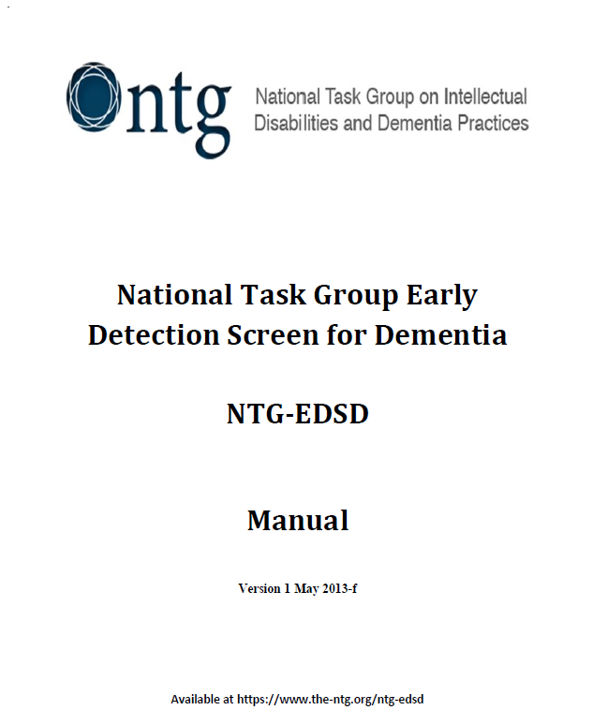
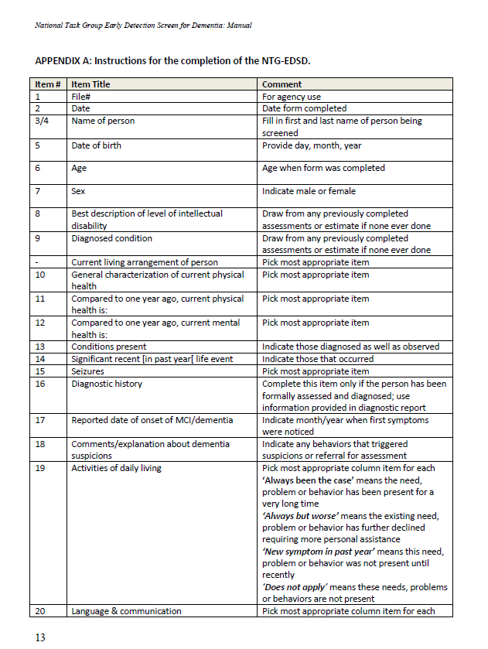
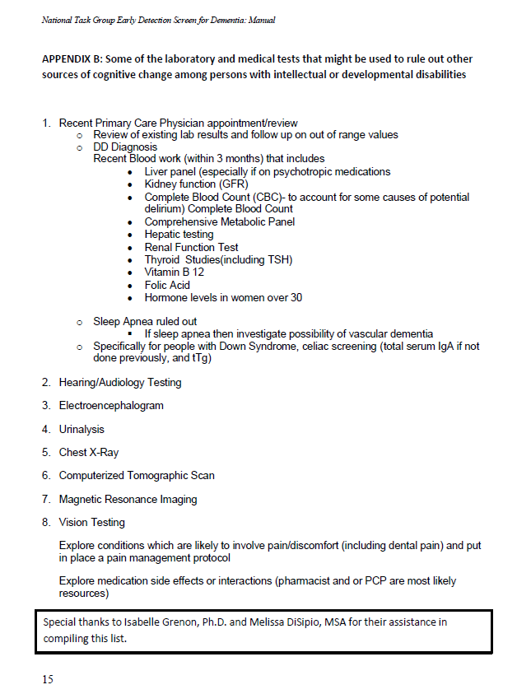
R/O lab & medical tests, page 15
Instructions, pages 13-14

Slide 16
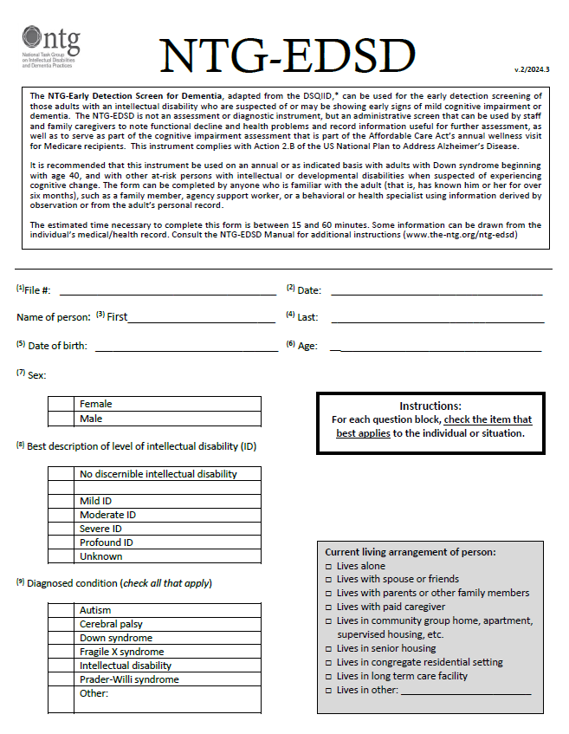
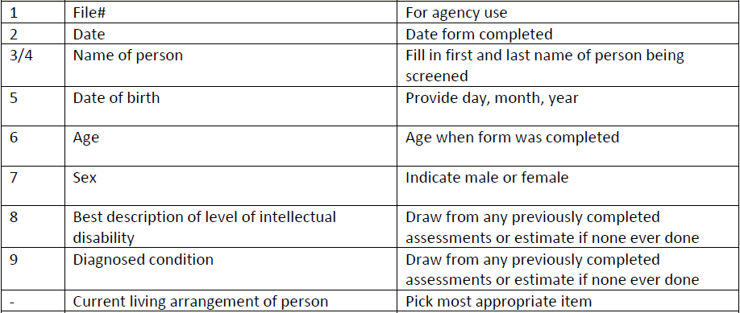
Page 1
Establish the individual's baseline,
then do annually or when a concern arises.
National Task Group Early Detection Screen for Dementia, NTG-EDSD, Manual

Slide 17
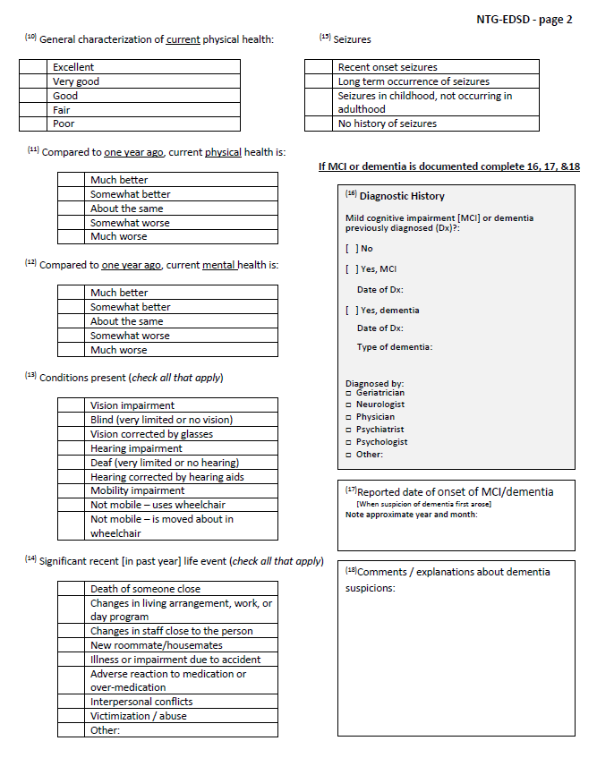
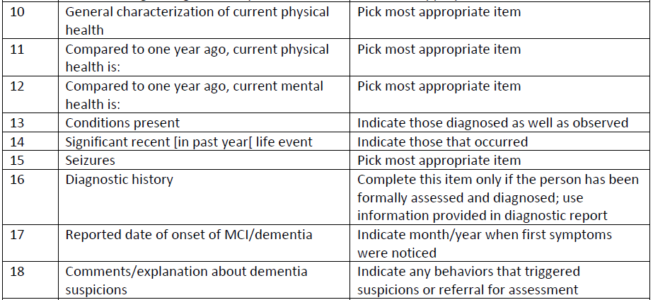

Page 2
Feel free to write in comments.
National Task Group Early Detection Screen for Dementia, NTG-EDSD, Manual

Slide 18
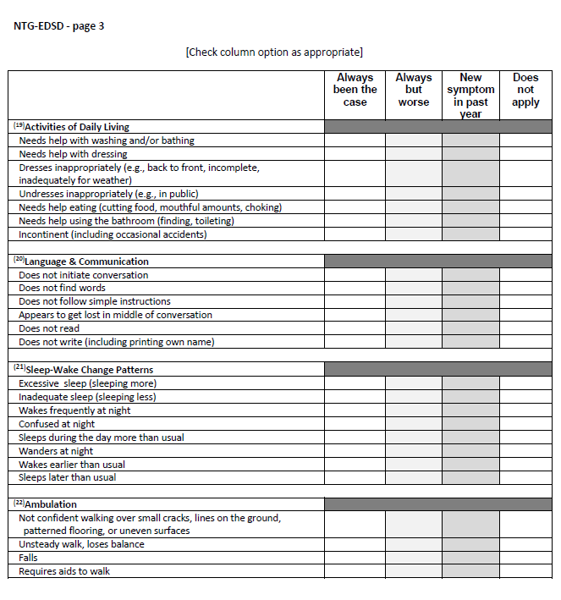
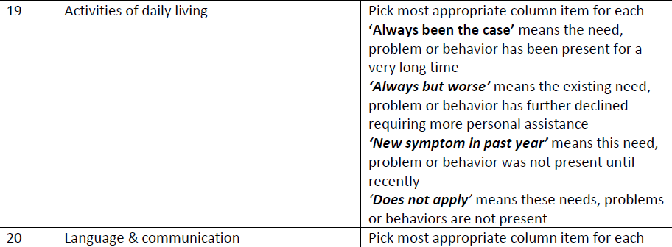

Page 3
Feel free to write in comments
National Task Group Early Detection Screen for Dementia, NTG-EDSD, Manual

Slide 19
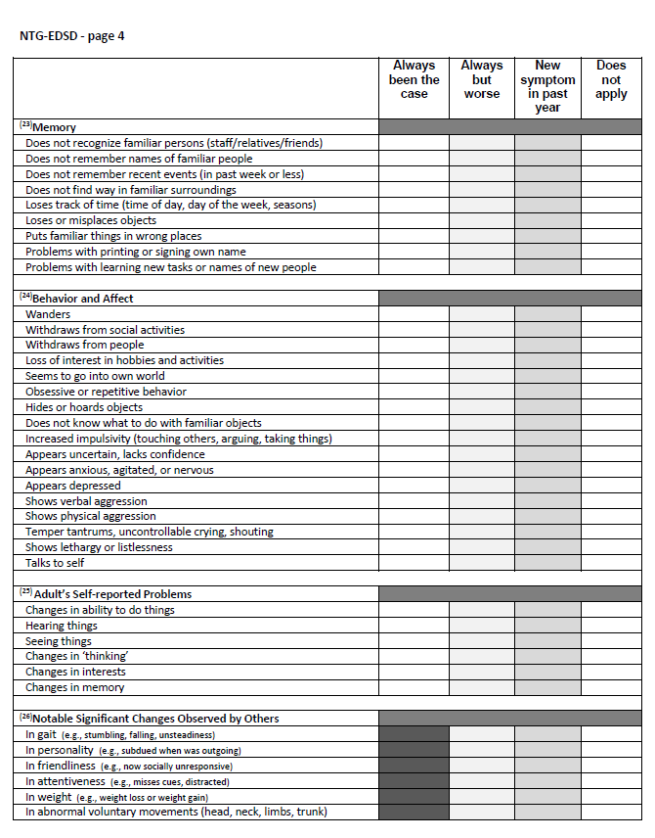
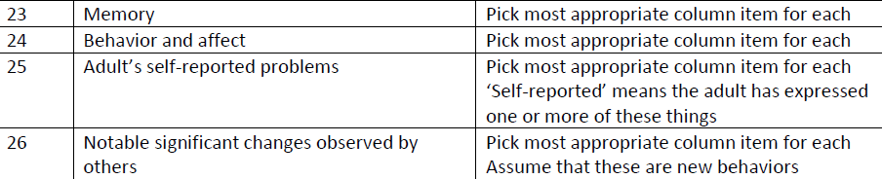
Page 4
Feel free to write in comments
National Task Group Early Detection Screen for Dementia, NTG-EDSD, Manual

Slide 20
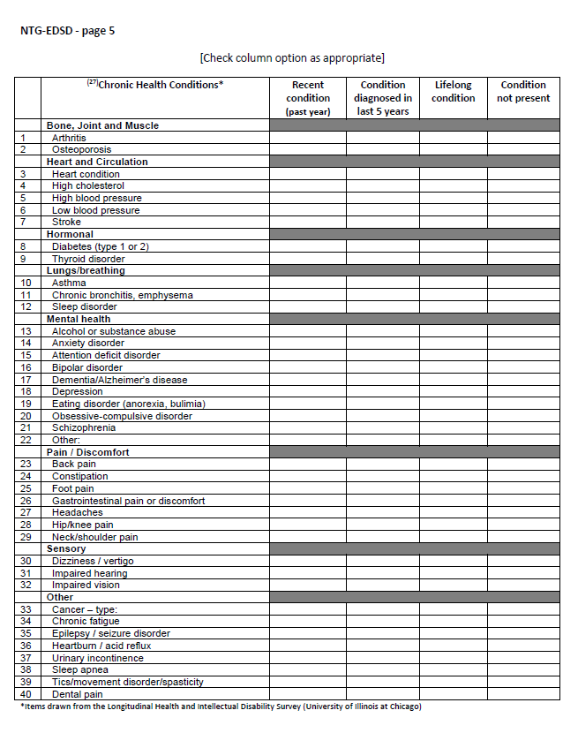
Page 5
Feel free to write in comments
National Task Group Early Detection Screen for Dementia, NTG-EDSD, Manual

Slide 21
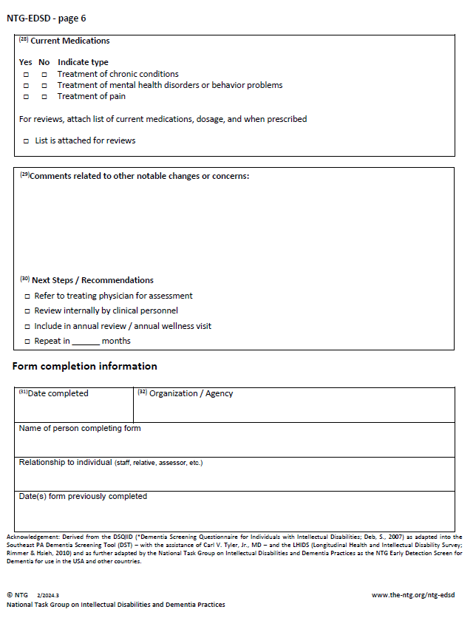
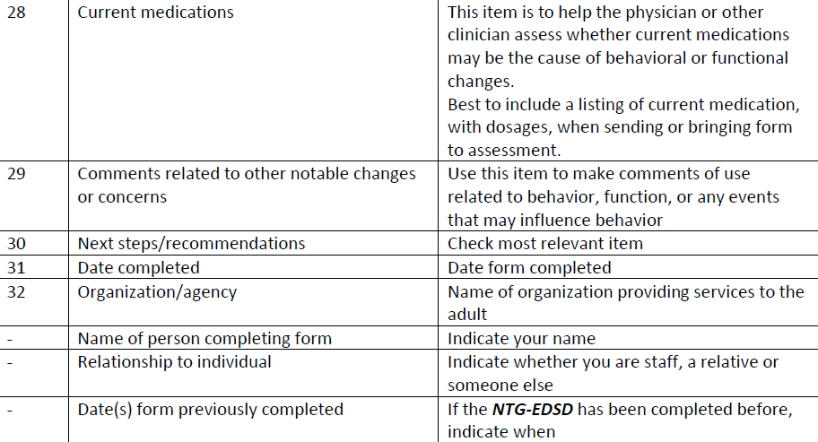
Page 6
National Task Group Early Detection Screen for Dementia, NTG-EDSD, Manual

Slide 22

Red Flags
“Signal items” are those items throughout the NTG-EDSD that are linked to the general warning signs of Mild Cognitive Impairment or early dementia, they include:
Unexpected memory problems
Getting lost or misdirected
Problems with gait or walking
New seizures
Confusion in familiar situations
Changes in personality
National Task Group Early Detection Screen for Dementia, NTG-EDSD, Manual

Slide 23

Application of the NTG-EDSD

Slide 24

Thoughts, Comments, Questions

Slide 25
Benefits in Using the NTG-EDSD
Helps to establish the person’s baseline, their norm.
Helps the person’s support system to become better observers.
Serves as an ongoing record of health and function.
Screening can help guide the health care provider in determining the evaluation course.
Screening can lead to early diagnosis, which allows for timely intervention and the ability to plan.

Slide 26
Drawbacks with the NTG-EDSD
Having someone available to do the screen who knows the client enough to fill out the screener.
A healthcare system may not have a process to incorporate the tool into the client’s medical record.
Many health care providers are unfamiliar with the screening tool.
May not be enough evidence to overcome diagnostic overshadowing.
Health care providers may not know what to do next.

Slide 27
Overcoming the Challenges in Diagnosing Dementia in Persons Living with IDD
Establish their personal baseline, their “norm” by completing the NTG-EDSD.
Consider having more than one person fill out the NTG-EDSD.
Do the NTG-EDSD annually and when cognitive changes are suspected.
Maintain records on the whole person (cognitive, medical, social, vocational, legal, behavior, function…)
Technology: video tape, audio tape (captures qualitative changes).

Slide 28
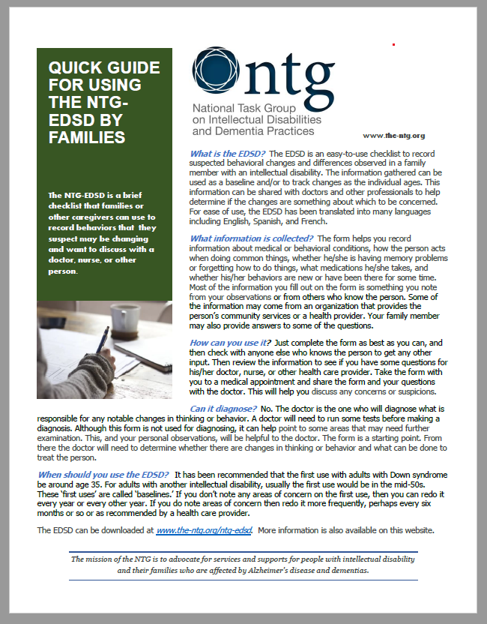

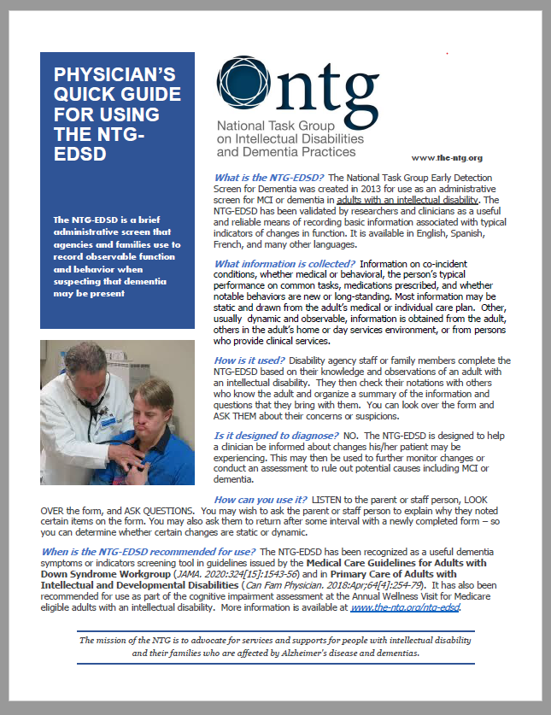
National Task Group’s Website
NTG-EDSD Form and Manual (multiple languages)
Quick Guide for Using the NTG-EDSD by Families
Quick Guide for Using the NTG-EDSD by Support and Care Staff
Physician’s Quick Guide for Using the NTG-EDSD
Additional materials and references
https://www.the-ntg.org/ntg-edsd

Slide 29






Thank you for your time and attention.
Jody Krainer, MSW, LCSW, MBA
NTG Affiliated Regional Trainer
Dementia Diagnostic Clinic Network Manager
Wisconsin Dementia Resource Network
jkrainer@wisc.edu

