Slide 1

Music as De-escalation
Regulating Emotions with Music
Ingrid Gruett
MMT, MT-BC, WMTR
Notes:
Thank you Dr. Braus
Introduce self, I am a board-certified music therapist, owner of Middleton Music Therapy Services, and a member of the Dementia Friendly Middleton and Madison. My master’s thesis focused on use of music therapy techniques to help persons with dementia. I work largely with persons living with dementia and IDD in the Madison area and though and throughout the US through online music therapy sessions.
Dr. Braus showed us why music can help us to de-escalate (or regulate) – so I will show you how I use music as a music in these situations in my work a a music therapist.

Slide 2
Emotion Regulation
“Emotion regulation is a term generally used to describe a person’s ability to effectively manage and respond to an emotional experience.”
Notes:
I like this definition from Cornell University – the normal highs and lows and the ability to return to homeostasis or a normal baseline

Slide 3
Emotion
Dysregulation
“Emotion dysregulation is the term used to describe an inability to regularly use healthy strategies to diffuse or moderate negative emotions.”
Notes:
Also from Cornell, emotion dysregulation is the opposite. It is the inability to easily get back to homeostasis or a normal baseline. For some people this is due to an extreme circumstance (i.e. someone who is in shock after an accident), for some people this happens more frequently during the course of normal daily events. This can apply to the general population, but when we refer to dysregulation in persons living with dementia, it is often referred to as “sundowning.”

Slide 4
Sundowning
Sundowning is a phenomenon associated with increased confusion, anxiety, agitation, and restlessness in people with dementia or Alzheimer’s, occurring specifically in the late afternoon or evening. It is a set of behavioral symptoms that often worsen as the sun sets.
Notes:
I like this definition from the Mayo Clinic.
The reason is really quite logical…

Slide 5
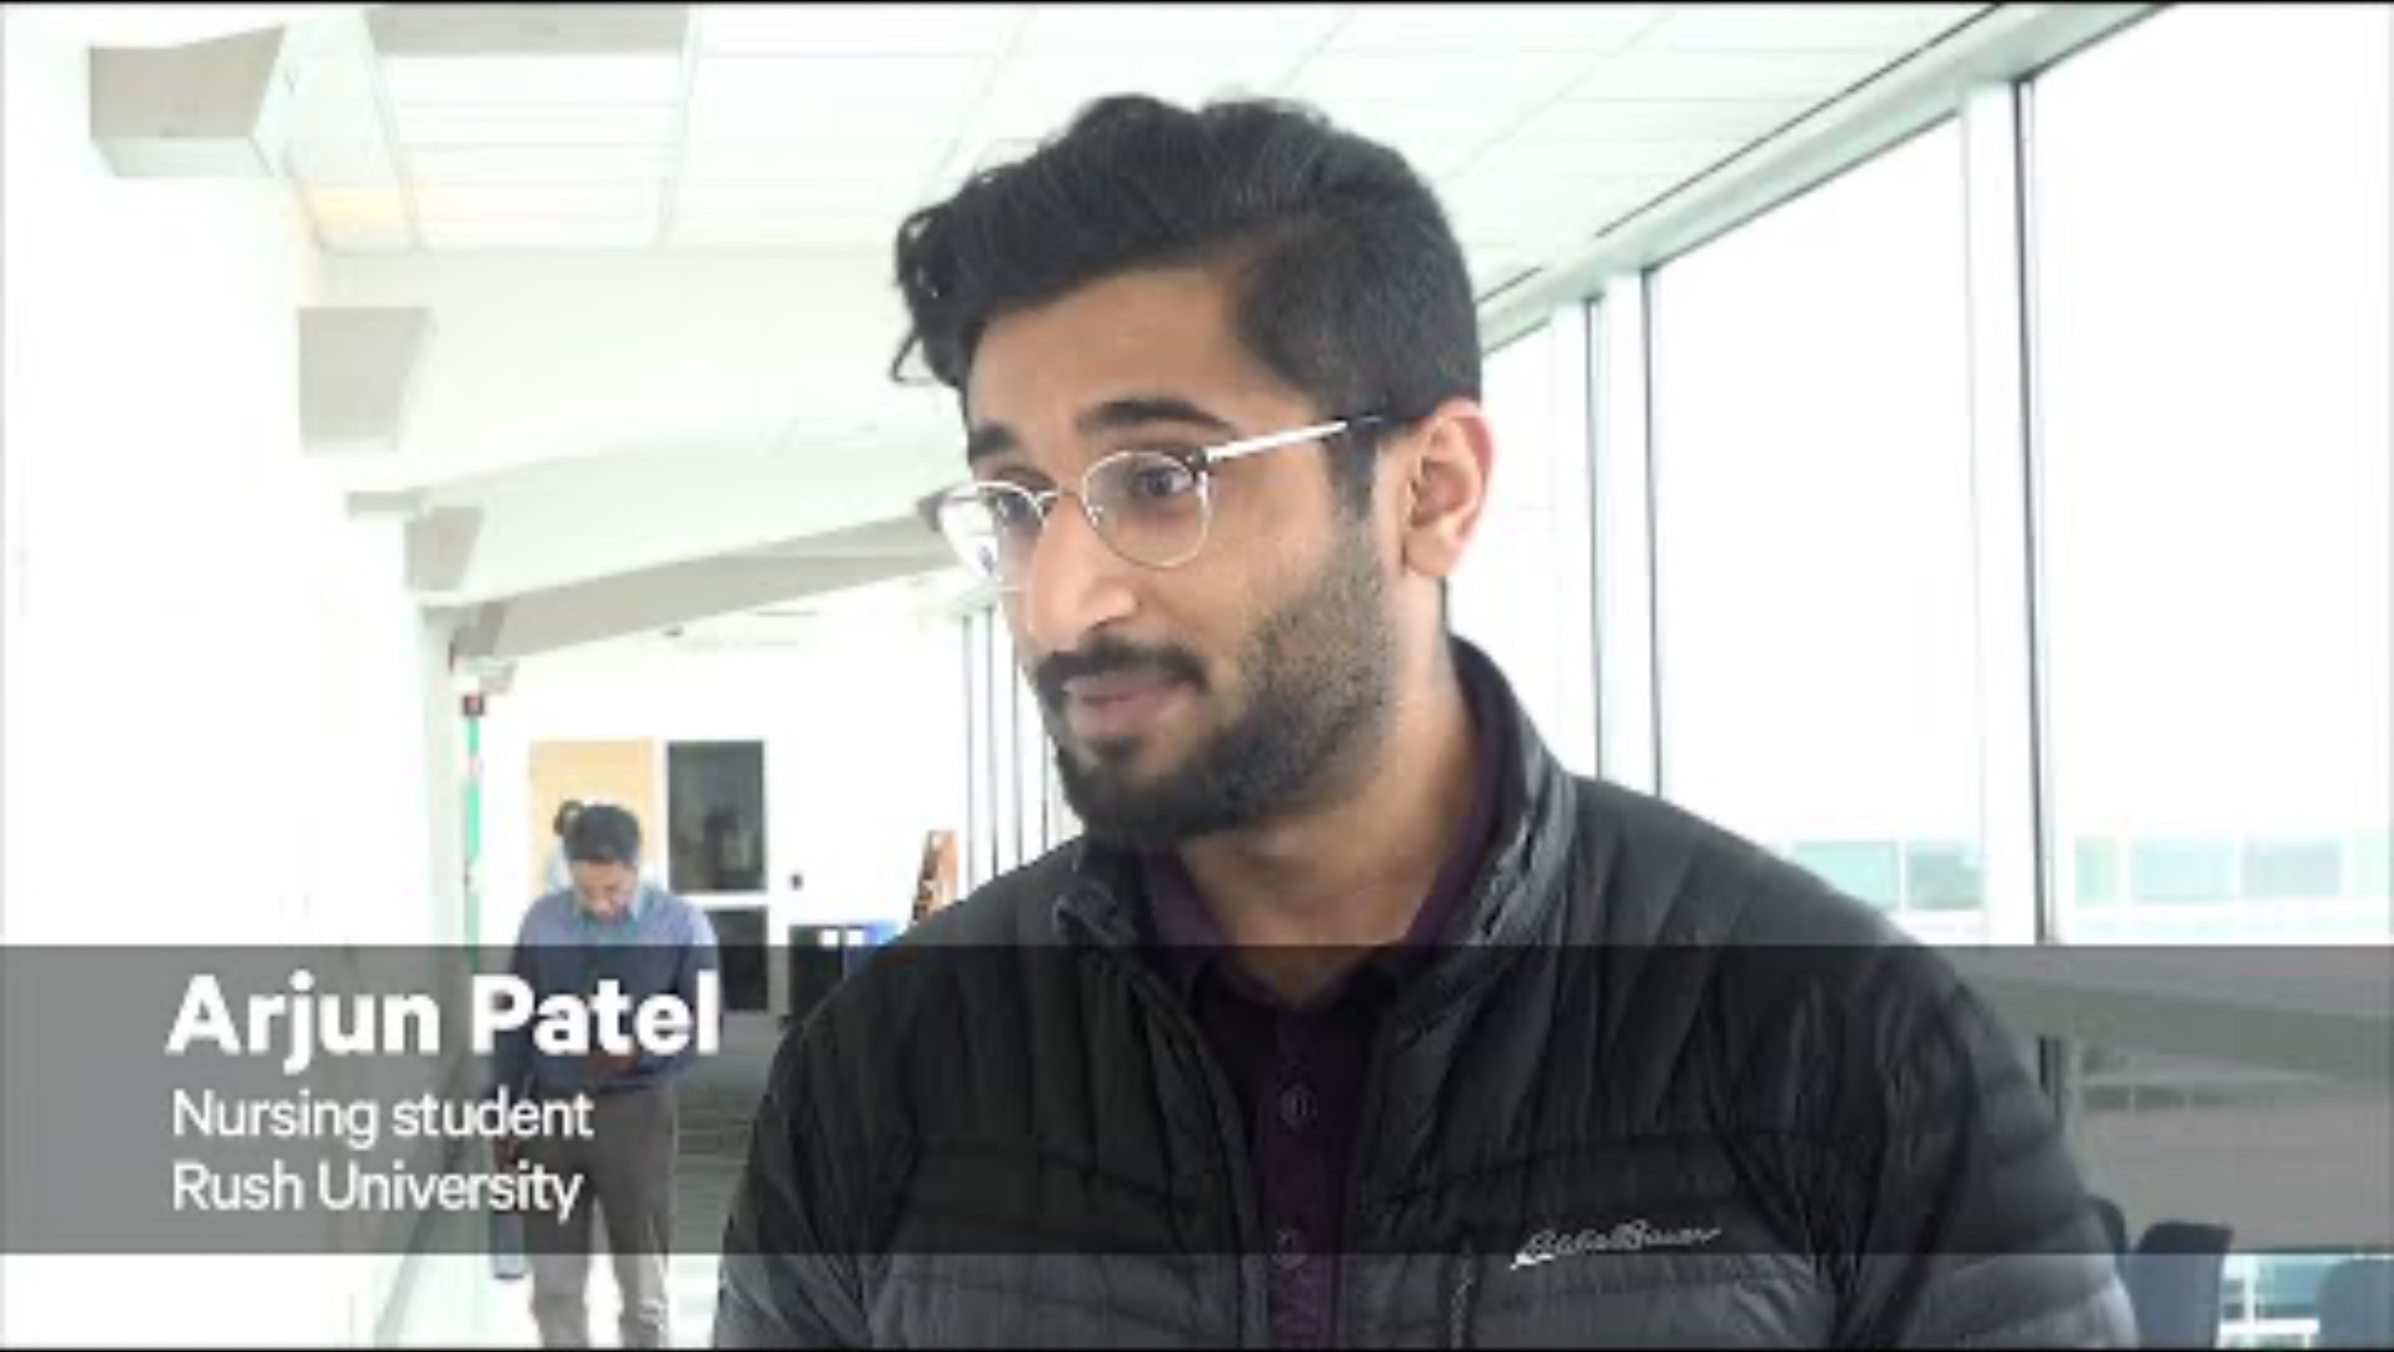
Virtual Dementia Experience
Notes:
Foster empathy – remember the experience and then decide what not to say – “I already told you” “stop it” or any kind of arguing (example of person waiting for someone)

Slide 6
Sensory Approaches
Prepare Yourself
Consider Environment
Physical Positioning
Validation
Breathing
Redirection
Notes:
Now that we understand the sensory changes that someone with dementia experiences, let’s look at how to approach stressful situations
Take a moment and calm yourself while trying to assess the situation – slow your movement and your speech (remember the virtual dementia experience)
Is it loud, overwhelming? Can you change it? (lights, volume) – is the person wear hearing aids?
Do not get in someone’s space, but also within the range that the person will notice you
There is an entire theory of working with persons living with dementia by Naomi Feil that includes validating where a person is coming from ”I can see why you are frustrated”
Try to help the person focus on something else – a person with dementia can be helped by noting what they are paying attention to and redirecting their attention to something else

Slide 7
Selective Attention
Selective attention is related to emotion regulation in that it is important for an individual to be able to shift and sustain their attention in order to achieve emotion regulation.

Slide 8
Attention Agitation
As orientation and sustained attention increase, agitation decreases.
Notes:
If we perseverate, we do not allow ourselves to return to emotion regulation. Someone with dementia needs help in achieving this. This applies to the technique of distraction as well, but in music we have an additional neurologic benefit called entrainment that can take us further than just distraction, into relaxation. (explain entrainment)

Slide 9
Use of Music
Gentle Humming
Singing
Tapping
Listening
Iso-Principle
Notes:
If can draw a person’s attention to something else, for instance music, they then have an opportunity to self-regulate. Slide for each bullet
Without using words:
Demonstrate taking a breath
Demonstrate humming/singing under breath
Demonstrate tapping with recorded music
Have go-to recorded general music
Play iso-principle – use tracks from George Winston Winter starting with Joy

Slide 10
Use of Music – Gentle Humming
Gentle Humming
Notes:
If can draw a person’s attention to something else, for instance music, they then have an opportunity to self-regulate. Slide for each bullet
Without using words:
Demonstrate taking a breath
Demonstrate humming/singing under breath
Demonstrate tapping with recorded music
Have go-to recorded general music
Play iso-principle – use tracks from George Winston Winter starting with Joy

Slide 11
Use of Music - Singing
Gentle Humming
Singing
Notes:
If can draw a person’s attention to something else, for instance music, they then have an opportunity to self-regulate. Slide for each bullet
Without using words:
Demonstrate taking a breath
Demonstrate humming
“do you know that one?”
Demonstrate tapping with recorded music
Have go-to recorded general music
Play iso-principle – use tracks from George Winston Winter starting with Joy

Slide 12
Use of Music - Tapping
Gentle Humming
Singing
Tapping
Gentle Humming
Singing
Tapping
Notes:
If can draw a person’s attention to something else, for instance music, they then have an opportunity to self-regulate. Slide for each bullet
Without using words:
Demonstrate taking a breath
Demonstrate humming/singing under breath
Demonstrate adding tapping with recorded music without speaking
Have go-to recorded general music
Play iso-principle – use tracks from George Winston Winter starting with Joy

Slide 13
Use of Music - Listening
Gentle Humming
Singing
Tapping
Listening
Gentle Humming
Singing
Tapping
Listening to Recorded Music
Notes:
If can draw a person’s attention to something else, for instance music, they then have an opportunity to self-regulate. Slide for each bullet
Without using words:
Demonstrate taking a breath
Demonstrate humming/singing under breath
Demonstrate tapping with recorded music
Have go-to recorded general music - ”Spa music” “General music” George Winston and Peder B. Helland
Play iso-principle with guitar – use a song with verses or from mood vecturing on iPad

Slide 14
Use of Music – Iso Principle
Gentle Humming
Singing
Tapping
Listening
Iso-Principle
Notes:
If can draw a person’s attention to something else, for instance music, they then have an opportunity to self-regulate. Slide for each bullet
Without using words:
Demonstrate taking a breath
Demonstrate humming/singing under breath
Demonstrate tapping with recorded music
Have go-to recorded general music
Play iso-principle with guitar – use a song with verses or from mood vecturing on iPad – Leaving on a Jet Plane

Slide 15
Middleton Music Therapy Services
Ingrid Gruett, MMT, MT-BC, WMTR
info@middletonmusictherapy.com
608-215-0416
Notes:
Look me up if you have other question or if you would like references from the presentation

Slide 16

Questions?

