Slide 1


IDD Crisis Stabilization in Dane County
Erin Kollenbroich, Dane County Human Services
Dave Verban & Axel Junker, UW-Waisman Center

Slide 2

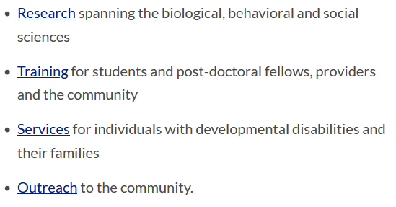

Slide 3

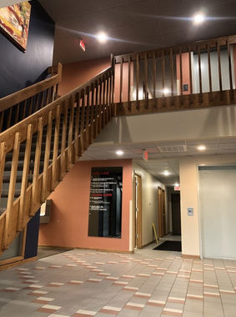
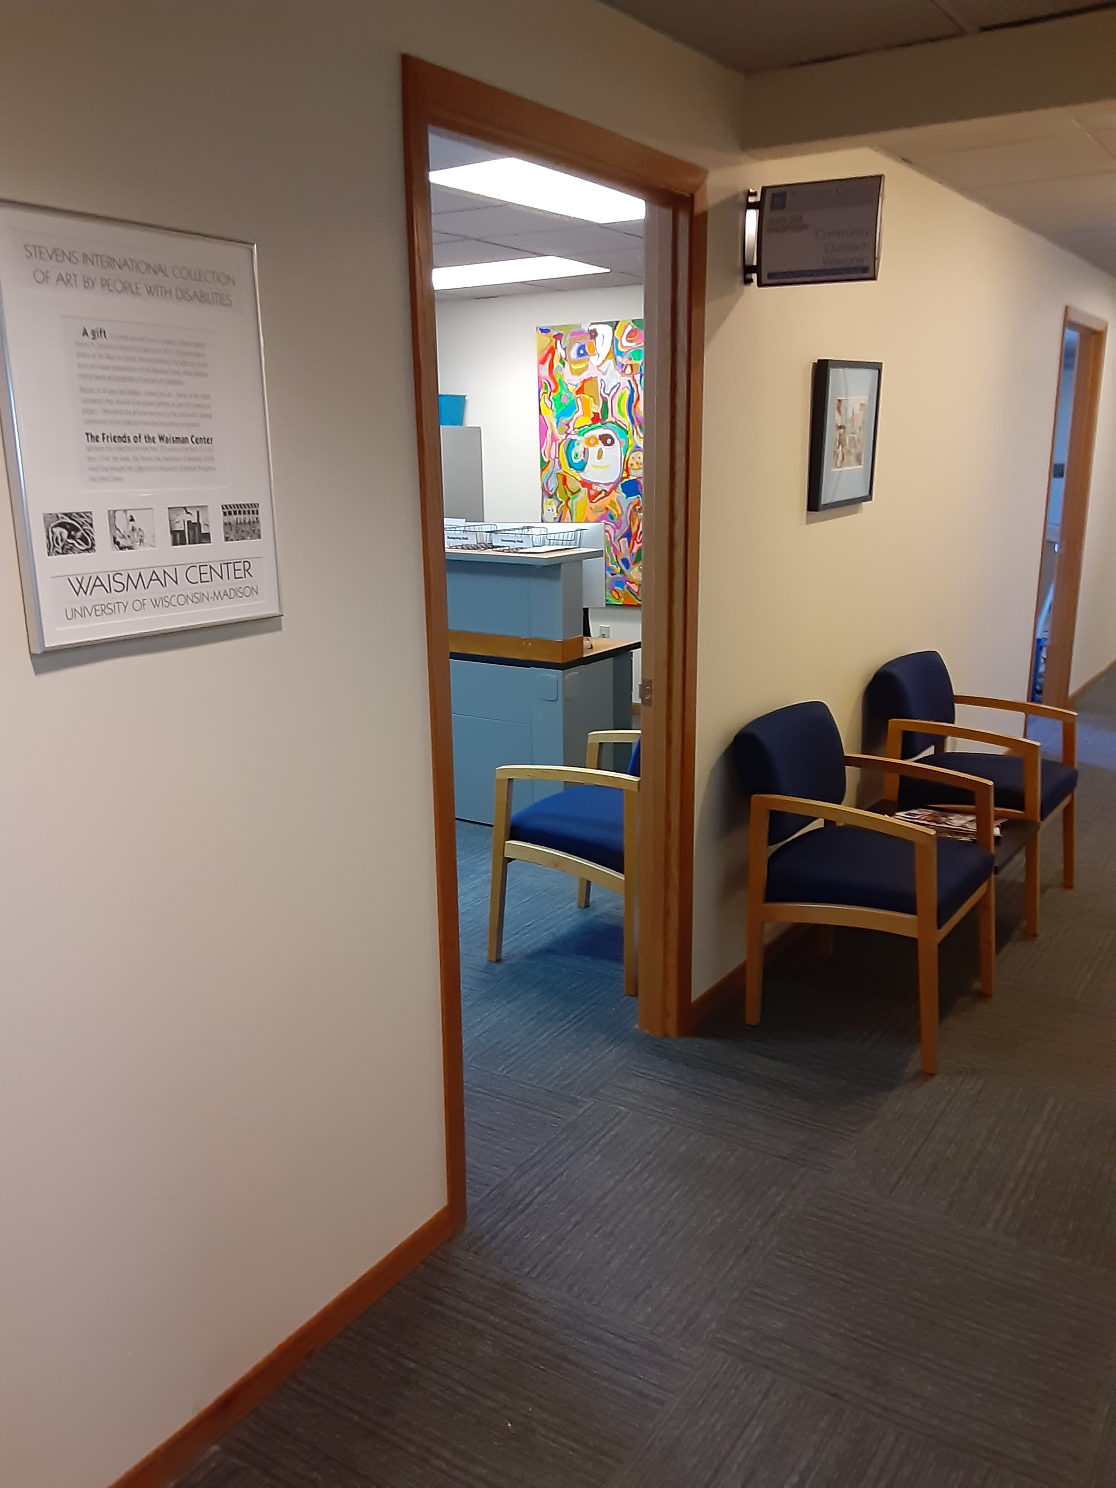
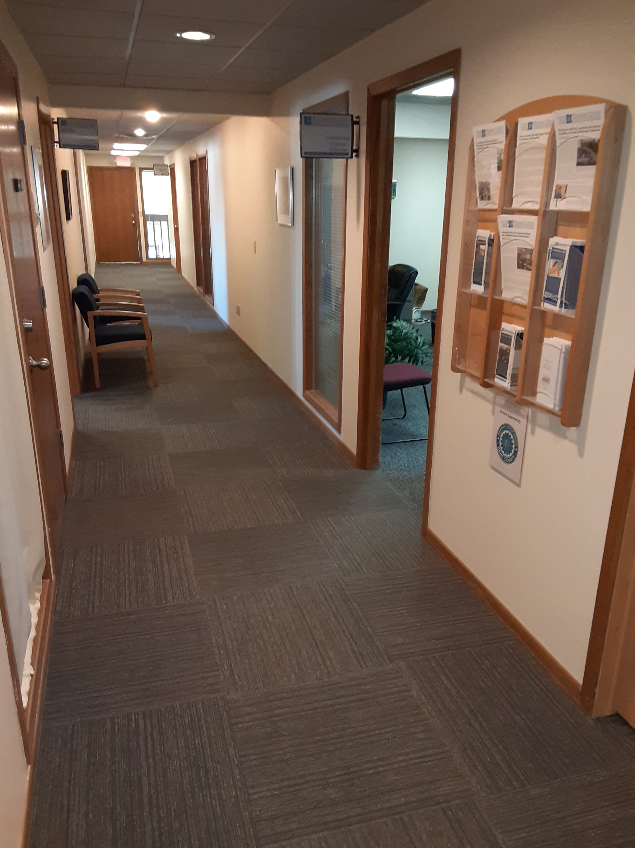
122 E. Olin Ave., Suite 255

Slide 4
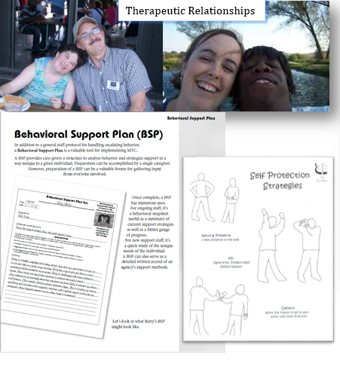
Community TIES: Behavioral Support

Slide 5

Meet individuals in their homes and workplaces, build relationships and collaborate with community teams on positive behavior supports based on the unique needs of the person.
Provide situational counseling and/or coordinate access to other available therapeutic resources in the community.

Slide 6
Write Behavior Support Plans that are focused on holistic and proactive approaches and provide personalized training to care givers.
Consult around specialized supports (which might include home modifications, consultation around clients’ rights or restrictive measures or pro-active outreach to emergency responders).

Slide 7

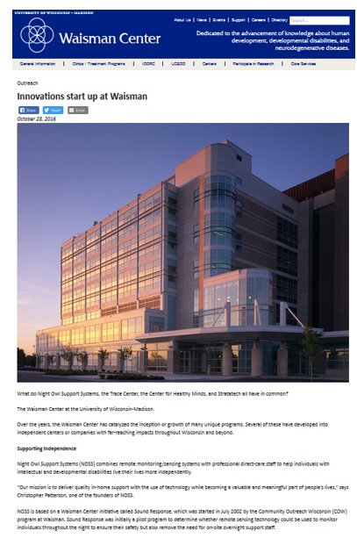

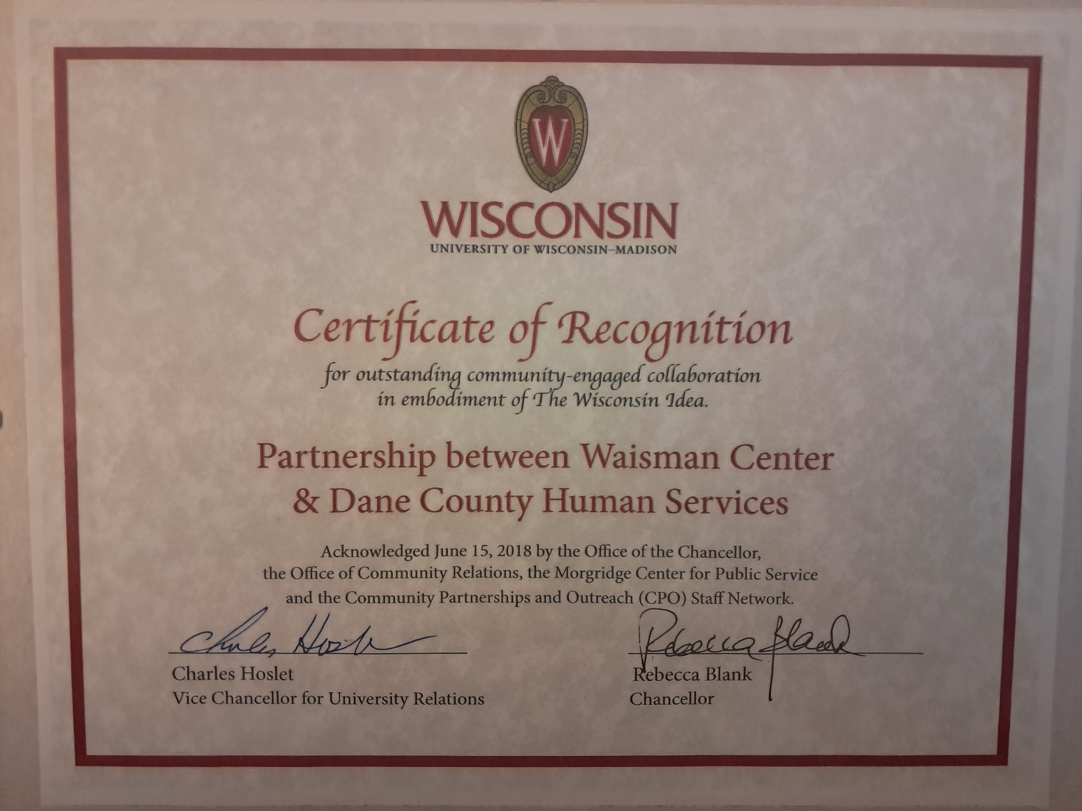
Partnership with Dane County Human Services

Slide 8
IDD and Mental Health services are not well integrated
Disability services traditionally focus on long term needs
Health care and other acute (mental health) services are typically paid through health insurance (Medicaid card) and are not necessarily coordinated with LTC entities
Mental Health practitioners often lack IDD experience or familiarity with IDD community services
There are barriers accessing mental health services
IDD providers often don’t view themselves as providing mental health supports

Slide 9
Individuals with complex behavior health needs often experience sudden, unexpected and drastic changes in support needs
Long Term Care/IDD services struggle to quickly (!) respond to changing needs because of
  Funding
  Policies & Procedures
  Capacity

Slide 10
Meanwhile in Behavioral Health
SAMHSA’s National Guidelines for Behavioral Health Crisis Care highlights that “crisis services are for anyone, anywhere and anytime”
Three core elements of the “Crisis Now” model:
Crisis Call Hub – Someone To Talk To
Mobile Crisis Team Services – Someone to Respond
Crisis Receiving and Stabilization Services – A Safe Place To Get Help
Follow-up and ongoing crisis supports are also key!

Slide 11
We strive to deliver crisis services across the continuum in a way that is…
Accessible
People know how to ask for help, and services are easy to understand and navigate. Programs are available in a timely manner and with minimal barriers.
Acceptable
Programs deliver care that feels like care. People are willing to ask for help and engage with services because they feel supported and treated with dignity.
Appropriate
The right help is offered at the right time. Services effectively target and address individual needs in the least restrictive manner and environment possible.
Accountable
Each program reliably fulfills its role and follows through
on its commitments to people in crisis, other programs, and the broader community.

Slide 12
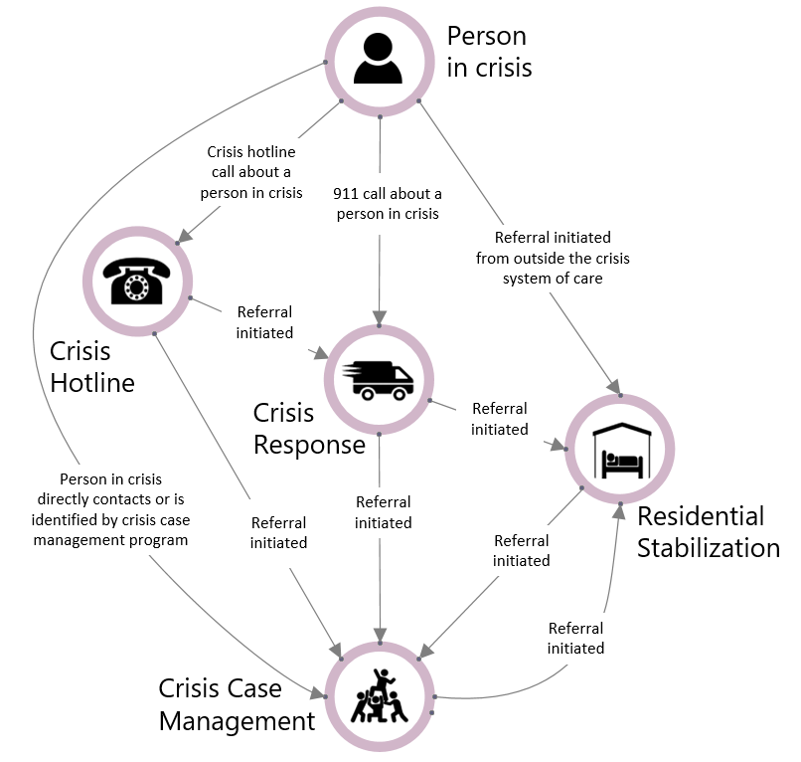

Dane Crisis Provider Network
Journey
(clinical
oversight)
DCDHS
(admin
oversight)
DHS 34
Certification
Working DCPN Purpose Statement:
The purpose of the DCPN is to foster collaborative relationships and transparent communication among a coordinated community of providers in order to deliver the right care from the right team at the right time.
Notes:
In Wisconsin, counties are required to provide emergency mental health services and those services are regulated by an administrative rule called DHS 34
In Dane County, DHS 34 Certification is jointly held by JMHC and the County – this certification allows us to bill Medicaid for crisis services
Relative the requirements of DHS 34 and Medicaid, Journey focuses on clinical aspects of oversight and the County on administrative oversight
There are a variety of different programs run by different agencies that operate under the umbrella of this certification – including the crisis hotline, mobile response, residential stabilization, and case management
Together these programs comprise a continuum of crisis care we call the Dane Crisis Provider Network or DCPN
The purpose of the DCPN is to foster collaborative relationships and transparent communication among a coordinated community of providers in order to deliver the right care from the right team at the right time
Key values that guide the work of the DCPN include: Collaboration, Adaptability, Growth, Trust, Diversity, Compassion
Launching the Dane Crisis Provider Network has been a collaborative effort between DCDHS and JMHC
Starting in 2024
Quarterly newsletter : disseminate information and updates, share training opportunities in a broad forum
Leadership convenings : time to connect with each other, discuss and problem solve
Fireside Chat Webinars: topics related to provision and coordination of crisis services

Slide 13
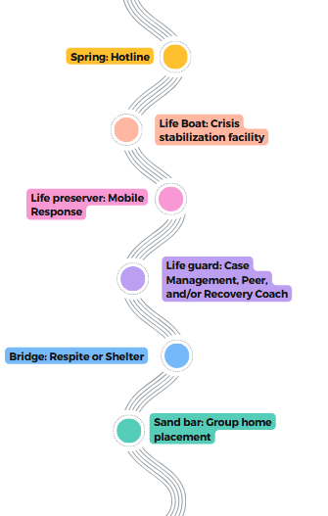
How does the DCPN work in practice?
DCPN River
Someone in Crisis may touch many different parts in the “River” during an episode of Crisis. No one’s crisis looks the same and the order is not always linear.
Notes:
Discuss how people
talk about how moving from program specific to person specific
In Response/ Crisis Plans

Slide 14
Waisman COW Crisis Stabilization
How are we funded?
Medicaid – Dane County Crisis Stabilization (No Prior Authorization Needed)
Who do we serve in crisis stabilization?
Adults, 18+
Dane County residents
IDD
Long term care eligible
Mental or behavioral health crisis

Slide 15
Waisman COW Crisis Stabilization
What services can we provide?
Linkage and follow-up
Assessment
Consultation with family / providers
Behavioral Support planning and coaching
Referral to additional services, as appropriate
Coordination across LTC support team members and mental health providers

Slide 16
Waisman COW Crisis Stabilization
Who can refer someone to Waisman Crisis Stabilization?
Self-referral
Family
Provider
Case Manager or IRIS Consultant
Journey Mental Health Crisis
CCS provider
ADRC
Anyone
Dave Verban, Waisman Crisis Stabilization Coordinator
dverban@wisc.edu
608-712-8670

Slide 17
Waisman COW Crisis Stabilization
Where do referrals come from?
Young adults in transition
Providers seeking additional support
Post emergency detention or protective placement
Out of county residents residing in Dane
Not enrolled in LTC but eligible

Slide 18

Questions?
dverban@wisc.edu
junker@waisman.wisc.edu
Kollenbroich.Erin@danecounty.gov

