Slide 1

Beyond Assumptions: Queer Elders in the Community
Increasing knowledge and skills, working towards spaces that are safe and affirming for everyone in the LGBTQ+ community

Slide 2
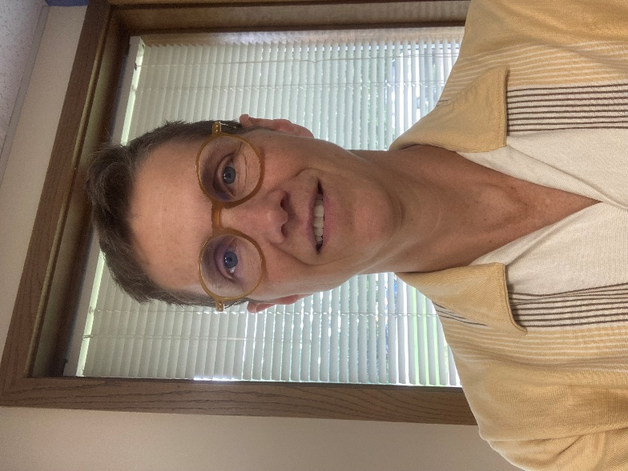
Presenters
Lynn Currie (she/they)
Elder Advocate
lynnc@lgbtoutreach.org
608-255-8582

Slide 3

OutReach LGBTQ+ Community Center
Programs
Housing - Willma's Fund and EverStrong
Harm Reduction and HIV Prevention
Transgender Services
LGBTQ+ Elder Services
Community Resources
Community Pantry
Earl Greely Memorial Library
David Bohnett Cyber-center
Magic Pride Festival!

Slide 4
Objectives for Today
Introduce some terms and ideas relevant to working with, understanding, and supporting the LGBTQ+ community.
01
Provide concrete steps to create and/or maintain affirming and inclusive environments for LGBTQ+ people.
02
Issues faced by LGBTQ+ Elders.
03

Slide 5
Group Agreements
Confidentiality: what is shared here stays, what is learned here leaves
Be open to learning new things and challenging assumptions
Expect unanswered questions and unfinished business
Are there ones that we want to highlight or others that we’d like to add?

Slide 6
The Language We’re Using
LGBTQ+ / LGBTQIA+
Lesbian, Gay, Bisexual, Transgender, Queer, Intersex, Asexual (or Agender)
“+” shows that there are more identities than listed
Queer: umbrella term for identities other than heterosexual/straight or cisgender
Is still considered by many to be a slur, so some people may object to its use
Typically indicates more politically active LGBTQ+ communities or individuals

Slide 7
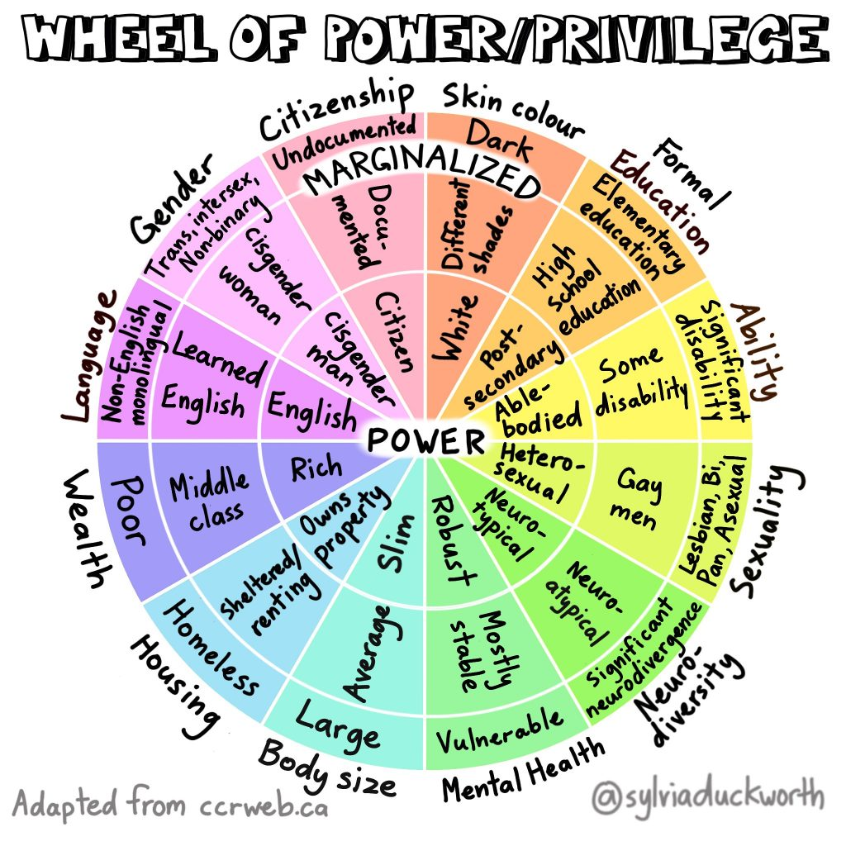
Intersectionality
The idea can be used to talk about overlapping forms of oppression that people of any identities face
Pushes back against idea that people experience one form of oppression or another
Notes:
https://www.youtube.com/watch?v=ViDtnfQ9FHc&ab_channel=NationalAssociationofIndependentSchools%28NAIS%29
https://www.vox.com/the-highlight/2019/5/20/18542843/intersectionality-conservatism-law-race-gender-discrimination

Slide 8
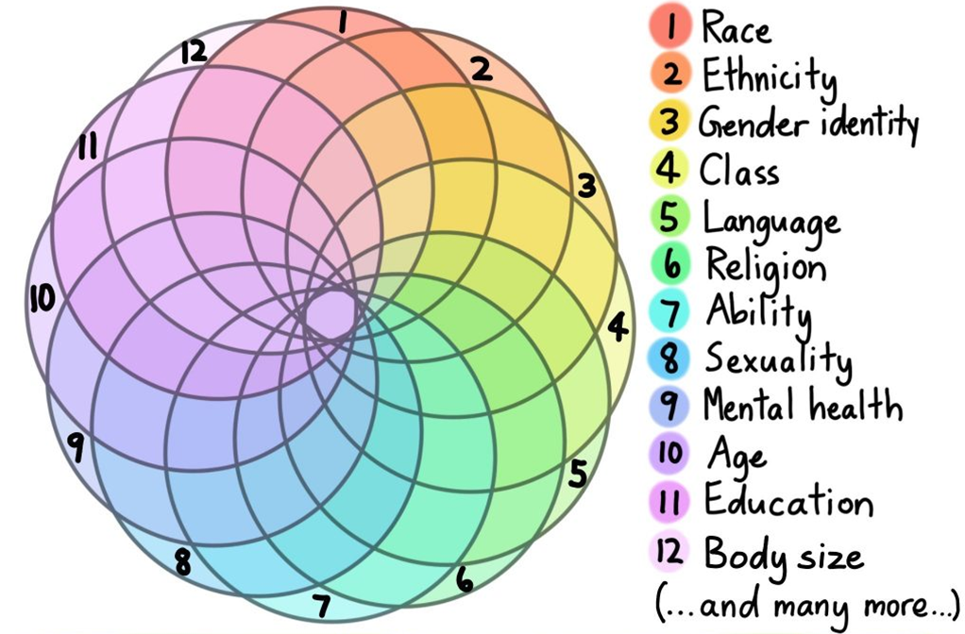
Relevance to Workshop
The LGBTQ+ community is not a monolith
Unified by political and social oppression
Made up of individuals, like all communities
Experiences of individuals are based on how the world perceives us
Certain people within the LGBTQ+ community are much more vulnerable than others
People within the LGBTQ+ community can and do engage in oppressive behaviors based on their privileged identities
Notes:
LGBTQ+ community in WI is on average younger than cisgender, heterosexual population
LGBTQ+ community in WI is more racially diverse – higher proportion of LGBTQ+ people are BIPOC compared to cisgender, heterosexual community.

Slide 9
Sexual Orientation
The gender(s) that someone is attracted to and how often or intensely they feel romantic or sexual attraction
There are many more terms than what is listed here. If someone uses one you are unfamiliar with, you can look it up or ask for clarification.
One gender | Two or more genders | No attraction
Lesbian, gay, straight | Bisexual, biromantic, pansexual, and many others | Asexual, aromantic, and others

Slide 10
Sex
Assigned at birth by a medical professional based on which genitals are present.
Biologically and naturally, there is a continuum of sexual variation in our species not just “male” and “female.”
Notes:
Natural variation in sex is part of evolution! Split gill mushrooms have 20,000 identified “sexes”!

Slide 11
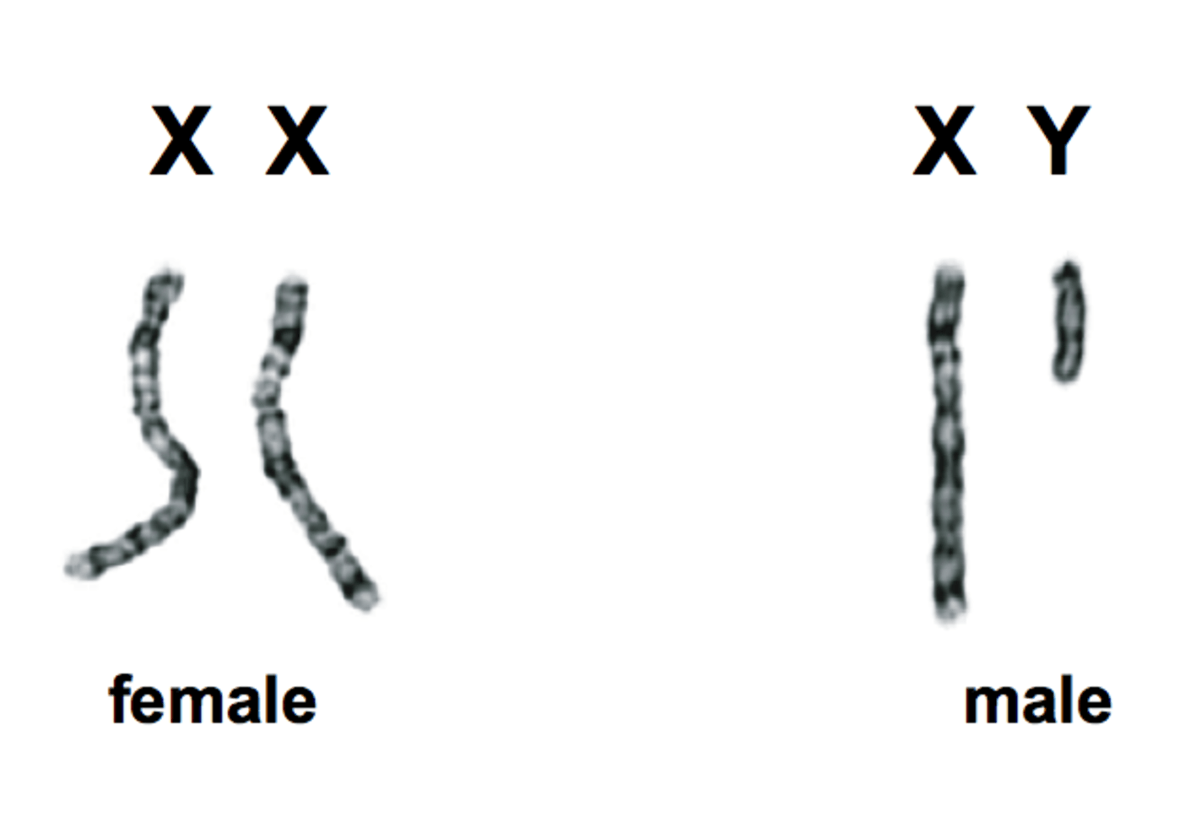
What is Intersex?
An umbrella term for conditions in which a person is born with physical or genetic characteristics that are neither strictly male nor female.
According to experts, around 1.7% of the population is born with intersex traits – comparable to the number of people born with red hair.
Reality is much more complicated!

Slide 12
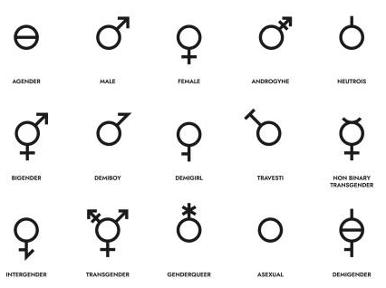
Gender
Gender: socially-constructed roles, expectations, and behaviors that we associate with masculinity, femininity, or a mixture of the two.
“Normal” genders vary between cultures, locations, decades/times, etc.

Slide 13
Which term to use?
Gender identity: internal and personal, how an individual understands and experiences their gender.
1
Gender expression: external and visible, how we communicate our gender to others.
2
Gender ≠ Gender Identity ≠ Gender Expression

Slide 14
Gender: Cisgender
A cisgender person is someone whose sex assigned at birth aligns with how they experience and express their gender.
Cisgender is used to describe someone, it’s an adjective.
For example: She is a cisgender woman.
Cisgender is often abbreviated as “cis.”

Slide 15
Gender: Transgender
A transgender person is someone whose sex assigned at birth does not align with how they experience and express their gender.
Transgender is also an adjective, a word used to describe someone.
For example: She is a transgender woman.
Transgender is often abbreviated as “trans,” and can be an umbrella term to group together binary and non-binary gender identities.
Gender
“Trans”
Sex Assigned at Birth

Slide 16
Gender: Non-binary
A non-binary person is someone who experiences and expresses their gender as something other or outside of the masculine and feminine gender binary.
Non-binary is also an adjective, a word used to describe someone.
For example: They are a non-binary person.
Non-binary can be an identity or another umbrella term for identities outside of the masculine/feminine binary.
Not all non-binary people describe themselves as transgender.

Slide 17
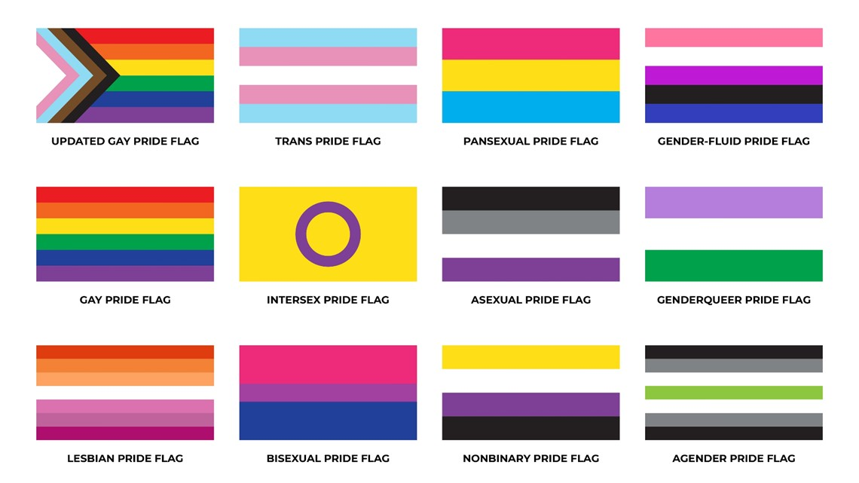
And many other gender terms…
Many other descriptive terms exist like genderqueer, agender, bigender, demiboy, demigirl, etc.
If we hear one that we're unfamiliar with, we can look it up later or ask (depending on relationship with person, the setting, and their safety).

Slide 18
Additional Important Terms
Transition: the process of affirming one’s gender through social, legal, medical, and/or surgical processes. Not all trans people come out or publicly transition, and not all trans people go through all these processes.
Misgender: Using pronouns or other words or adjectives that do not align with someone’s gender.
For example: using she/her pronouns for a man that uses he/him pronouns.
Deadname: Using someone’s former name instead of the name they currently use.

Slide 19
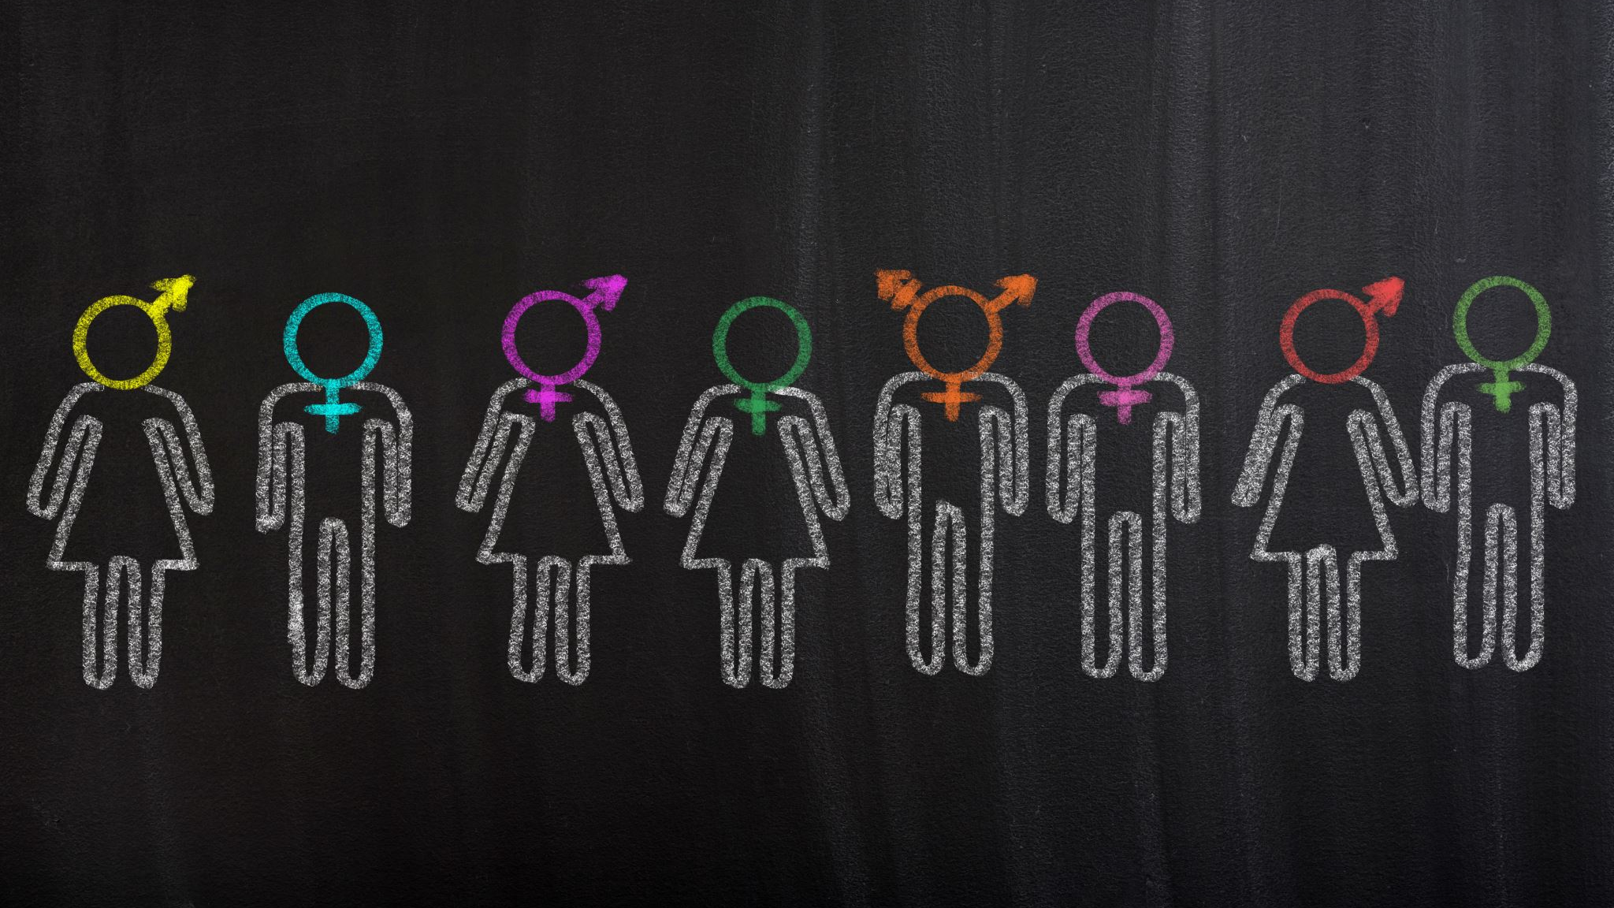
Pronouns

Slide 20
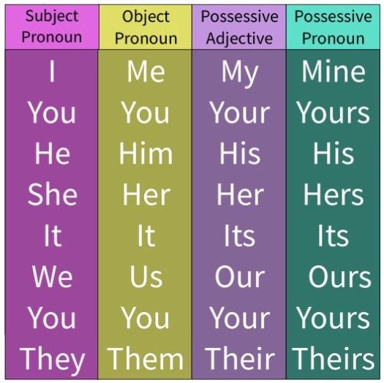
What is a pronoun?
A part of speech that we use in place of repeatedly saying someone’s name when referring to them
We all have them and use them
Most people clearly identify with one or more sets of pronouns, even if we don't consciously think about it

Slide 21
Common English Pronouns
She/her/hers
He/him/his
They/them/theirs

Slide 22

Importance of Using Correct Pronouns
Correct pronoun use:​
Demonstrates respect and listening​
Starts building belonging​
Incorrect pronoun use:​
Has a significant negative effects on mental health
Transgender people who are accepted and affirmed by their coworkers and colleagues have better mental health and lower rates of suicidal ideation

Slide 23

Affirming and inclusive behavior

Slide 24

Why Use Gender-Inclusive Language?
Even though it can be challenging to adopt because we are raised to think of gender roles in our society as "normal" or "ideal“…
Gender-inclusive language:
Decreases exclusion of people based on gender
Increase inclusion of transgender, non-binary, and gender expansive people
Demonstrates that we value each other and respect each other's humanity

Slide 25
Examples of Gender-Neutral Language
Gendered Language | Gender-Neutral Language
He or she, (s)he, s/he | They
Him or her | Them
His or her(s) | Their(s)
Both genders | All genders
Opposite gender, opposite sex | Different gender
Chairman | Chair, chairperson
Fireman | Firefighter
Husband or wife | Spouse or partner
Father or mother | Parent

Slide 26

Recognize and Question Biases
Biases: tendency, preference, or prejudice towards or against something
Most often based on stereotypes or “general knowledge”
Are a normal thing to identify in ourselves and something we can actively work to unlearn
Bias questionnaires can be helpful to self-reflect
Can help identify areas of discomfort where we need to work on ourselves
Biases often lead to harmful assumptions about someone's identity or behavior
Notes:
https://files.lalgbtcenter.org/pdf/rise/Los-Angeles-LGBT-Center-RISE-Frequently-Encountered-Biased-Questions-Statements.pdf
file:///C:/Users/MT-1/Downloads/learning-to-address-implicit-bias-towards-lgbtq-patients-case-scenarios.pdf
https://www.cdc.gov/healthyyouth/disparities/mai/pdf/LGBTQ_Inclusivity-508.pdf

Slide 27

Assuming Sexuality
Avoid guessing or assuming someone’s sexual orientation based on how they act, dress, speak, or other things
This includes the assumption that heterosexuality/being straight is “normal”
Use gender neutral language when talking about/asking about partners unless/until you know differently

Slide 28
Assuming Gender
Avoid idea that we can know someone's gender based off of how they dress, speak, act, move, or anything else.
Cisgender and transgender women don't have to be feminine
Cisgender and transgender men don't have to be masculine
Non-binary people don't have to be androgynous
Gender and pronouns may be different
Feminine-appearing person can use he/him pronouns

Slide 29

Be Aware of How Bias Shows Up
Biases can show up as subtle, indirect, or unintentional instances of discrimination and harm directed at marginalized communities
With or without intending to, our biases can cause us to engage in exclusionary behaviors that make people feel unwelcome or unable to be themselves

Slide 30
Examples of Exclusionary Behavior
Verbal or nonverbal cues that indicate discomfort with LGBTQ+ people
“I don’t care if you’re gay, trans, whatever, I just don’t want to know about it.”
Erasing the existence of sexuality and gender variation in global history
“There weren't any of these non-binary people when I was growing up.”
Denial of privacy
“Are you on hormones?” or “Who’s the man in the relationship?”
Assuming a universal LGBTQ+ experience or culture
“Don’t you all love Lady Gaga?” or “Gay men have it so easy.”

Slide 31
Issues for LGBTQ+ Elders

Slide 32
What do LGBTQ+ Elders Need?
Acceptance & Respect
Access to Services
Inclusion of Important People
Right to be Known & to be Authentic
Right to Privacy
Notes:
People at every level must play a role in ensuring that the culture, mission, vision, and practices are inclusive and welcoming for the LGBTQIA+ community

Slide 33
Issues for LGBTQ+ Elders Historical and Ongoing
Stigma
Reliance on Families of Choice
Less Likely to Marry
Less Likely to Have Children or Have Children Removed
Estrangement from Family of Origin
Unequal Treatment: Laws/Regulations
Less Access to Community/Healthcare Spaces
Criminalization and Pathologizing
Access to Care, Jobs, Marriage Benefits, etc. Dishonorable Discharge.
Made to Feel Unwelcome in Certain Settings
Impact of Stigmatizing Laws
Forms/Policies/Marketing
Microagressions
Notes:
Boomers are 1st generation who were able to be out
Stigma –
Cause
Nazi Death Camp
DSM/Pathologizing
Criminalizing
Childen taken away
Religious rejection: immoral, anti-family, evil…
Impact
Going back in the closet (history of hiding)
Avoiding Care
Being Excluded (then: marriage, military, closeted with employer/family, …) (now: bathrooms, sports, gender affirming care)
Micro-aggressions - “Don’t worry, ALL of our volunteers are welcoming” “sisters, now twins” “what about the sex” “one topic ‘friends’” “you don’t belong in this bathroom – vigilante justice”
Reliance on Families of Choice
80% of caregiving is done by family members (non LGBTQ+)
Historical ability to have children / be recognized as parent
AIDS decimated communities/social networks even within the community
Ask: “Who in your life is especially important”
Unequal Treatment –
Less Access
Unequal Access - 70% go back into closet for congregate care. Church welcoming? Bullying?
Shortage of Inclusive Third Spaces
Access to…. (care, jobs, benefits, honorable discharge)
Implicit Bias
Who can stay together in congregate living
Access to Gender Affirming Care
Forms
Presumption of Heterosexality and Cis-Identy
Potential Negative Impacts:
Impoverished survival spouse -
Poorer Health: Delayed Care, health care discrimination,
Higher Rates of self-medication/Addiction
Higher rates of mental health concerns
Unreported Domestic Abuse
Loneliness/Isolation
Lower Income/Assets: Medicaid, long-term care, retirement plans, pensions, partner benefits, inheritance taxes, VA benefits, cost for lawyers to guarantee as many rights as possible
Higher levels of suicidal ideation

Slide 34
Laws, Regulations, Program Guidelines – Historical & Current
Public Benefit Programs
Access to Marriage, Health Care
Estate Taxes & Inheritance Laws
Private & Military Benefits
Child Custody
Notes:
Past
Denial of Benefits
Lack of Inheritance / Death/Survivor Benefits
Lost Child Custody
Public Benefits – different spend-down rules, income rules for Nursing Home
Current Laws, Regulations, etc - In 2025, the ACLU tracked 616Anti-LGBTQ bills in the U.S.
Gender Affirming Care
Access to Sports
Church
Bathroom access
NEED a POA (like everyone) – Costs of court battles. Some states exclude “close friend”
VA exclusion of Transgender service members – cut off access to pensions for many who were very close to eligibility
Passport application or renewal
New voting laws – mis-matched birth certificate, unable to renew passport with preferred pronouns
Marriage in 2015
DSM until 1973
Sodomy Laws until 2003

Slide 35
Resilience
Chosen Family
Mutual Aid
Joy & Celebration of Identity
More?
Notes:
Underground networks?
More Likely to be Caregivers

Slide 36
Checklist for Inclusion & Safety
“Do you have LGBTQ+ residents/clients?” Most likely
Include Staff at all Levels
Review Policies:
Visitation
Definition of Family
Pronouns
Make no assumptions about sexual or gender identify
Move beyond “equal” to “responsive”
“Who will care for you when you leave the hospital?”
Don’t assume there aren’t children in the house
Become comfortable speaking in support of LGBTQ+ issues
Is same sex visitor assumed to be partner or friend?
Set an example of Inclusion “beyond the rainbow sticker in the window):
Diverse leaders, staff, volunteers
Create space for staff to be out
LGBTQ literature in office
Visual ‘proof’ of inclusion – marketing materials, partnerships, and visible proof: (photos/videos online, art inside, “beyond the window sticker”)
Don’t ‘out’ folks – let them tell, or not tell, who they are (people are who they say they are)
LGBTQ+ Community Advisory Board/Partners
Offer Training
Notes:
Underground networks?
More Likely to be Caregivers

Slide 37

Closing and Reflections
What Can YOU Do?

Slide 38

Commit to On-Going Education
Seek out high-quality, reliable sources of information.
Look for things written by people who are a part of the community that you are learning about.
Misinformation is harmful and often perpetuates dangerous and potentially deadly stereotypes.
LGBTQ+ people currently target of massive misinformation campaigns in the US.

Slide 39

Get and Stay Connected
Stay up-to-date with what is impacting the LGBTQ+ community where you live.
Are there anti-LGBTQ+ laws or policies being put in place by school boards or local governments where you live?
What are LGBTQ+ people doing to counter discrimination and how can you support their efforts?
Find events, activities, fundraisers you can attend for the LGBTQ+ and allies.
If you’re an ally, think about what you can do to be supportive like volunteering!
What is happening within your organization or community to exclude LGBTQ+ folks?
Notes:
Intake Forms – wife/husband
Assumptions – assumed to be straight
Tokenization – “sister” “twin” inappropriate questions

Slide 40
Reflection
Share one concrete take-away you have from today’s workshop and discussions and how you can bring that into your work.

Slide 41
Additional Resources
Intersectionality:
https://www.exploratorium.edu/explore/intersectionality
https://www.youtube.com/watch?v=ViDtnfQ9FHc&ab_channel=NationalAssociationofIndependentSchools%28NAIS%29
https://www.vox.com/the-highlight/2019/5/20/18542843/intersectionality-conservatism-law-race-gender-discrimination
Bias Questionnaires:
https://files.lalgbtcenter.org/pdf/rise/Los-Angeles-LGBT-Center-RISE-Frequently-Encountered-Biased-Questions-Statements.pdf
https://www.cdc.gov/healthyyouth/disparities/mai/pdf/LGBTQ_Inclusivity-508.pdf
OutReach LGBTQ+ Community Center: https://www.lgbtoutreach.org/​
Our Lives Magazine, a Wisconsin-based publication covering LGBTQ+ topics: https://ourliveswisconsin.com/​
FORGE, a Wisconsin-based non-profit focused on mental health and wellbeing of transgender and non-binary people of all ages: https://forge-forward.org/
Gender Neutral Pronouns. FORGE, February 2021. https://forge-forward.org/resource/gender-neutral-pronouns/
Core Concepts Resource Guides, FORGE. https://forge-forward.org/resources/core-concepts/ Pronouns.org​
City of Madison Gender Inclusive Language Style Guide
ACLU Anti-LGBTQ+ bill tracking. https://www.aclu.org/legislative-attacks-on-lgbtq-rights-2025
National LGBTQ Taskforce: https://www.thetaskforce.org/
LGBTQ Movement Advancement Project: https://www.lgbtmap.org/
Sage National Resource Center on LGBTQ+ Aging: https://lgbtagingcenter.org/

Slide 42
Sources re: LGBTQ+ Elders
Wisconsin LGBTQ History Project: https://www.wislgbthistory.com/
“Radical Family: Trailblazing Lesbian Moms Tell Their Stories”
2010 AARP report: /www.lgbtmap.org/file/improving-the-lives-of-lgbt-older-adults.pdf
Healthcare Equality Index: https://www.thehrcfoundation.org/reports/healthcare-equality-index
Sage National Resource Center on LGBTQ+ Aging: Home - LGBTQ Aging Center
Project Visibility (Boulder Co): https://bouldercounty.gov/departments/community-services/area-agency-aging/project-visibility/. YouTube video: https://www.youtube.com/watch?v=tqnVxzIRBHA
ACLU – Tracking of 298 Anti-LGBTQ+ bills in the US: https://www.aclu.org/legislative-attacks-on-lgbtq-rights-2026

