Slide 1


Thank you for joining this webinar on the 2021 Dane County Youth Assessment
We plan to begin shortly after 11:00 AM

Slide 2
Dane County Youth Assessment 2021 Highlights
December 9, 2021
Presented by Brian Koenig
K12 Associates, LLC

Slide 3
DCYA in 2021
The project is funded by:
  Dane County Human Services,
  United Way of Dane County,
  Public Health Madison & Dane County
  City of Madison
  20 school districts (2 new)
A county-wide survey given to 7th-12th grades every 3 years, started in 1980
In 2021, approximately 26,000 7th-12th student population completed the survey (weighted population)

Slide 4
Purpose of the DCYA
Leads to a better understanding of the Dane County youth needs and interests.
Informs community programs and government policy making.
Supports grant writing for school districts and other community organizations.
Provides important data for a variety of researchers in Dane County and across the U.S.

Slide 5
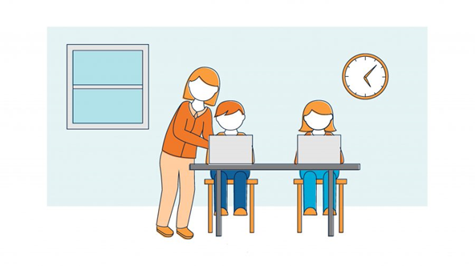
How is it administered?
School staff administer the online survey from late January to mid-April
Students are assured their responses are confidential
Survey topics & survey design is vetted by community partners, school districts and students
Validity and consistency of administration reflected in DCYA data matching national & state trends

Slide 6
Topics Covered
Alcohol, drugs and tobacco
Nutrition, exercise and health
Home life
Community involvement
Sexual behavior
Working and volunteering
Extra-curricular activities
Life at school
Future plans
Emotional/mental health
COVID impact

Slide 7
Please chat in…..
What topics are you most interested in hearing about today?
Do you have any specific questions you are hoping to have answered?

Slide 8
Who took the Youth Assessment?
Grades 7th-12th

Slide 9
Other Characteristics
7th-12th grades
4.3% of HS students who identify as either non-binary, gender fluid or other for gender identity (2.7% in 2018)
1.9% say they are transgender and 2.6% were not sure (combined nearly 1,400 students)
22.7% say they are not straight/heterosexual for sexual orientation (it was 14.3% in 2018)

Slide 10
Alcohol Consumption by Grade
Any Alcohol Last 12 mos. (9th-12^{th grades})

Slide 11
Alcohol Use
9th-12^{th grades}
High school alcohol consumption (last 12 months) has decreased county wide from 2012, 2015, 2018 and now in 2021 (43%, 35%, 31% to 23%)
On CRAFFT addiction screener 9% of HS students were at risk of addiction (13% 2018 and19% in 2015)
However, nearly 30% of HS drinkers were at risk of addiction (3 or more on CRAFFT)
Also, 45% of drinkers are using marijuana (last 12 months)

Slide 12
Alcohol Use
Subgroups (9th-12th grades)
38% of HS seniors have been drinking in the last 12 months, down from 51% in 2018
27% of HS girls drank in the last 12 months and 19% of boys (31% of boys and 30% of girls 2018)
Alcohol use highest among white and multi-racial students (25% and 24% respectively)
Alcohol use lower for Hispanic and African-American students at 17% and 12% respectively
Among students who drank during COVID the most common source was parents (36% of drinkers)
55% of the drinkers were at a home where the parents knew kids were drinking

Slide 13
Marijuana Use by Grade
Marijuana Last 12 mos. (9th-12^{th grades})

Slide 14
Marijuana Use
Subgroups (9th-12th grades)
16% of HS girls used marijuana (last 12 months) and 12% of boys (22% of boys and 20% of girls 2018)
Marijuana use highest among multi-racial students at 20%. White, Hispanic and African-America all about 15%.
63% of kids who’ve used marijuana (or THC) have used it in a vaping device.

Slide 15

Other Drugs
9th-12^{th grades}
Non-prescription 2.4% (6.3% 2018, 5.0% 2015)
Prescription medication abuse 1.6% (4.5% 2018, 4.4% 2015)
All other drugs at or below 1%.
75% of HS students with prescription drugs in their home, say they are kept in a place they can easily access them. (78% in 2018)

Slide 16
Tobacco, E-cigarettes
9th-12th grades
8% of HS students used electronic vapor cigarettes in the last 30 days (19% 2018,16% 2015)
15% of 12th graders are vaping (27% 2018, 23% 2015)
About 1% HS students are using regular cigarettes down from 3% in 2018

Slide 17
Reflection Questions
While self-reported alcohol, drug, and tobacco use by HS students was already on a downward trend prior to 2021, the COVID-19 pandemic likely further impacted this decline as students were isolated from their friends, other peers, schools, and the community.
Since the return to in-person classes and out-of-school-time activities, have you seen – or do you anticipate seeing – any changes to these youth substance use trends?

Slide 18
Up Past 11pm School Nights
9th-12th grades

Slide 19
Trends in Student Sleep
9th-12th grades

Slide 20
Emotional Health Trends
9th-12th grades since 2009

Slide 21
Who are the anxious students?
9th-12th grades
Using DCYA 3-item anxiety scale
53% female say they are anxious always/often (23% of males)
64% LGBQ say their anxious
51% who struggle with homework are anxious
58% with more than 3 items on the CRAFFT scale are anxious
50% of students from lower income families are anxious
More likely to use alcohol (31%) and marijuana (20%)

Slide 22

What are students anxious about?
9th-12th grades
When asked if they experience any anxiety, 87% said yes, some.
Reasons for anxiety (chose 3 most important reasons):
  Pressure to perform in school – 60%
  Too much homework – 57%
  Problems in the US/world – 30%
  Concerns about COVID -27%
  Social pressure to be popular, look good – 17%
  Pressure to have money, things (phone, clothes) – 12%

Slide 23
Emotional Health for Sexual Minority Students (9th-12th grades)
LGBQ youth report more emotional health issues
  64.7% always or often feeling anxious compared to heterosexual youth at 30.4%
  Higher anxiety about school performance (73.2% compared 57.0% for straight students)
  More worries about problems in the US and the world (46.3% compared to 24.1% for heterosexual students)
  More than twice as likely to feel depressed at 58.2% for LGBQ kids compared to 24.2% for straight kids.
  Also far more self-harm (cutting) and suicide ideation for LGBQ

Slide 24
Mental Health Services
9th-12th grades
83% says it’s OK to get professional mental health services (50% of students in 2012)
22% of students are receiving mental health services (about 3500 students)
Students using services, 17% in 2018 and 12% 2015
Long-term (6 months+) emotional or mental health issues:
  Anxiety 32%
  Depression 21%
  ADD/ADHD 13%
  Trauma 7%
  Eating disorder 5%

Slide 25
Mental Health Services
9th-12th grades
(continued)
58% of students who say the have long-term, emotional or mental health issue are not getting services.
54% of students who describe more frequent suicide ideation are not getting mental services
Among higher anxiety students, LGBQ kids less likely to be getting mental health services.
Some differences by race (White students more likely to be receiving services)

Slide 26
National College Health Undergrad Assessment 2020
26
The National College Health Assessment, fall 2020. 40 US campuses (including UW System schools)
Top impediments to academic performance
  Stress 45%
  Anxiety 35%
  Depression 26%
  Sleep difficulties 26%
Females equal to males on marijuana, but more likely to consume alcohol and far more likely to binge drink.
75% of undergrads feel sleepy 3 or more days per week

Slide 27
Reflection Question
This week, the Surgeon General released a report warning of ongoing, nationwide youth mental health crisis exacerbated by the pandemic.
Local data show that stigma related to accessing mental health services has declined in recent years and Dane County has made significant investments to increase mental health services.
Aside from working to increase the number of mental health care providers in schools and surrounding communities, what other ideas do you have for supporting the mental health of our youth during the pandemic and beyond?

Slide 28
Community Involvement
9th-12th grades
Have you been involved in any social activism, like marches or protests? 25% said yes
People working together can make changes: 97% agree
My voice makes a difference: 74% agree
  Hispanic or Latino students: 79.0% agree
  Black/African-American students: 76.1% agree
  Biracial or multiracial students: 74.7% agree
  White students: 72.7% agree
Conversations about racial injustice or inequality
  32% have talked a lot with friends or family about it
  17% have not talked about it at all.

Slide 29
School and Academics
9th-12th grades
51% of students said they fell behind in school during COVID
54% said they struggle getting homework done (44% in 2018)
33% of students missed or cut a scheduled class (19% in 2018)
I feel like a I belong at this school - 77% (same as 2018)

Slide 30
After School Activities
9th-12th grades
73.2% of students were involved in some extracurricular activity or afterschool program (83.5% in 2018)
40.1% of students said they missed some or all of a planned extracurricular activity due to COVID restrictions
Participation in sports dropped significantly from 61.9% in 2018 to 27.0% in 2021
22.5% were involved in an afterschool program or activity at school or community center (26.9% in 2018)
27.6% were involved in art, band, music or dance after school (31.2% in 2018)

Slide 31
Connection with Parents
9th-12th grades
10% say they have a parent with a mental health problem that worries them
  These students have double the levels of depression, anxiety and suicide ideation
51.0% say their parents talk to them about things that bother them (the student).
Students are more likely to talk with parents about after HS plans (82.9%) than friends (34.5%) or school staff (51.2%)
64.5% said they talked about healthy dating and relationships with their parents – but only 44.7% said they talked with their parents about birth control

Slide 32
Family Financial
9th-12^{th grades}
28% of students say financially “things are tight” but their families are doing OK. 2% say their family is struggling financially. (34% and 4% in 2018)
7% said they had to skip meals because their family didn’t have enough money (10% in 2018)
About 60% of students said they didn’t think money was a problem for their family right now – nearly identical to 2018.
35.0% of high school youth with a job, say their earnings help support their family.

Slide 33
Reflection Questions
Community
School
Home
Young Person
Risk and protective factors for youth exist at multiple levels of their environment.
These factors interact to influence a young person’s experiences, thoughts, behaviors, and outcomes.
How do you see risk and protective factors at different levels interacting?
More specifically, do you see protective factors at one level counteracting risk factors at another level (or vice versa)?

Slide 34
Dating, Sexual Violence
9th-12th grades
44.5% of students said they have gone out with someone or dated in the last 12 months (53.1% in 2018)
Nearly 10% of HS females say they have been forced to take part in sexual activity
  58.0% of these youth have some suicide ideation
  52.8% have done something to hurt themselves like cutting
17.8% of HS females say they have been pressured or encouraged to participate in sexual photos or videos

Slide 35
Gangs and Access to Guns
9th-12th grades
15.7% of students say they have access to a gun
  22.3% of students with higher levels of suicide ideation have access to a gun
  42.2% of rural students have access to a gun compared to 5.2% of urban youth.
Less than 1% of students say they are a member of a gang. 2.9% say they have a close friend who is a member of a gang.

Slide 36
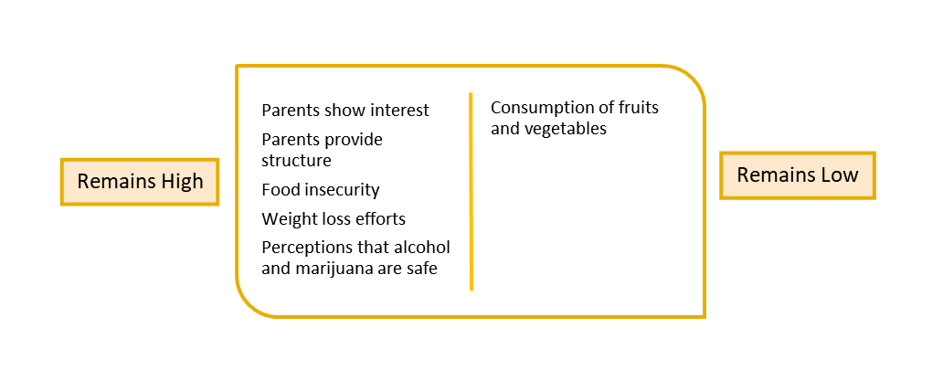
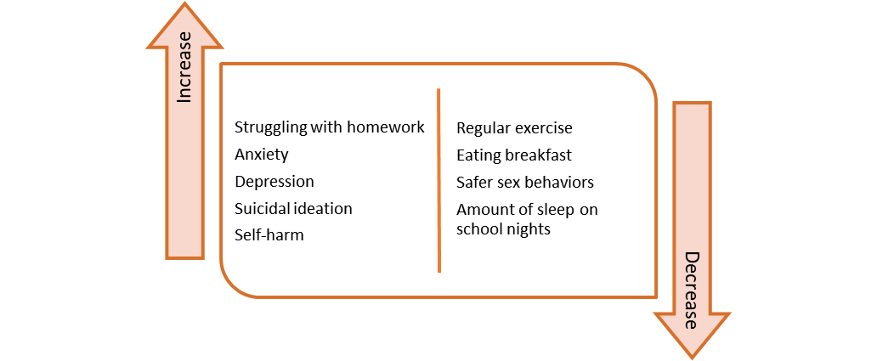
Notable Trends
DCYA 2012-2021
36
Increase
Family meals
Decrease
Bullying
Sense of belonging at school
Receiving mental health services
Smoking cigarettes/ tobacco use
Alcohol use
Marijuana use
Binge drinking
Sexual activity
Illegal drug use

Slide 37
What additional questions do you have?

Slide 38
Thank you!
Just a reminder that the DCYA is a community-led and community-owned research project!
If you would like access to the data or have additional questions about the survey, please contact:
  Meghan Benson at meghan.benson@ppwi.org
  Megan Meinen at meinen.megan@countyofdane.com
  Brian Koenig at bwkoenig@k12associates.com

